Slide 1
Dan Jurafsky and James Martin
Speech and Language Processing
Chapter 6:
Vector Semantics

Slide 2
What do words mean?
First thought: look in a dictionary
http://www.oed.com/

Slide 3
Words, Lemmas, Senses, Definitions
lemma
sense
definition

Slide 4
Lemma pepper
Sense 1: spice from pepper plant
Sense 2: the pepper plant itself
Sense 3: another similar plant (Jamaican pepper)
Sense 4: another plant with peppercorns (California pepper)
Sense 5: capsicum (i.e. chili, paprika, bell pepper, etc)

Slide 5
A sense or “concept” is the meaning component of a word

Slide 6
There are relations between senses

Slide 7
Relation: Synonymity
Synonyms have the same meaning in some or all contexts.
  couch / sofa
  big / large
  automobile / car
  vomit / throw up
  Water / H₂0

Slide 8
Relation: Synonymity
Note that there are probably no examples of perfect synonymy.
  Even if many aspects of meaning are identical
  Still may not preserve the acceptability based on notions of politeness, slang, register, genre, etc.
The Linguistic Principle of Contrast:
  Difference in form -> at least some difference in meaning : e.g. water/H₂O

Slide 9
Relation: Antonymy
Senses that are opposite with respect to meaning. Otherwise, they are very similar!
  dark/light short/long fast/slow rise/fall
  hot/cold up/down in/out
More formally: antonyms can
  define a binary opposition or be at opposite ends of a scale
    long/short, fast/slow
  Be reversives:
    rise/fall, up/down

Slide 10
Relation: Similarity
    Words with similar meanings. Not synonyms, but sharing some element of meaning
      car, bicycle
      cow, horse

Slide 11
Ask humans how similar 2 words are
word1 | word2 | similarity
vanish | disappear | 9.8
behave | obey | 7.3
belief | impression | 5.95
muscle | bone | 3.65
modest | flexible | 0.98
hole | agreement | 0.3
SimLex-999 dataset (Hill et al., 2015) gives values on a scale from 0 to 10

Slide 12
Relation: Word relatedness
Also called "word association"
Words can be related in any way, perhaps via a semantic frame or field
    car, bicycle: similar
    car, gasoline: related, not similar

Slide 13
Semantic field/Frames
Words that
  cover a particular semantic domain
  bear structured relations with each other.
  hospitals
  surgeon, scalpel, nurse, anaesthetic, pharmacy
  restaurants
  waiter, menu, plate, food, chef
  houses
  door, roof, kitchen, family, bed

Slide 14
Relation: Superordinate/ subordinate (Taxonomic)
One sense is a subordinate of another if the first sense is more specific, denoting a subclass of the other
  car is a subordinate of vehicle
  mango is a subordinate of fruit
Conversely superordinate
  vehicle is a superordinate of car
  fruit is a superordinate of mango
Superordinate | vehicle | fruit | furniture
Subordinate | car | mango | chair

Slide 15
Superordinate Basic Subordinate
chair office chair
piano chair rocking chair lamp torchiere
Furniture desk lamp
table end table coffee table

Slide 16
Connotation
Words have affective meanings
positive connotations (happy)
negative connotations (sad)
positive evaluation (great, love)
negative evaluation (terrible, hate).

Slide 17
So far
Concepts or word senses
  Have a complex many-to-many association with words (homonymy, multiple senses)
Have relations with each other
  Synonymy
  Antonymy
  Similarity
  Relatedness
  Superordinate/subordinate
  Connotation

Slide 18
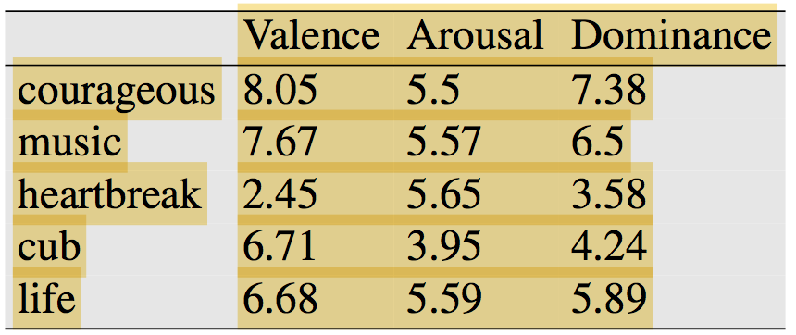
But how to define a concept?
Osgood et al., 1957 found that words varied along three important dimensions of affective meaning.
valence: the pleasantness of the stimulus
arousal: the intensity of emotion provoked by the stimulus
dominance: the degree of control exerted by the stimulus
This revolutionary model represents each word as a point in a three- dimensional space, a vector by taking word’s rating on the three scales.

Slide 19
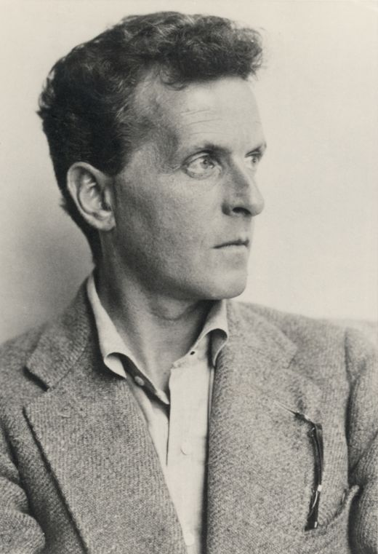
Ludwig Wittgenstein (1889-1951)
Philosopher of language
In his late years, a proponent (advocate of theory) of studying “ordinary language”

Slide 20
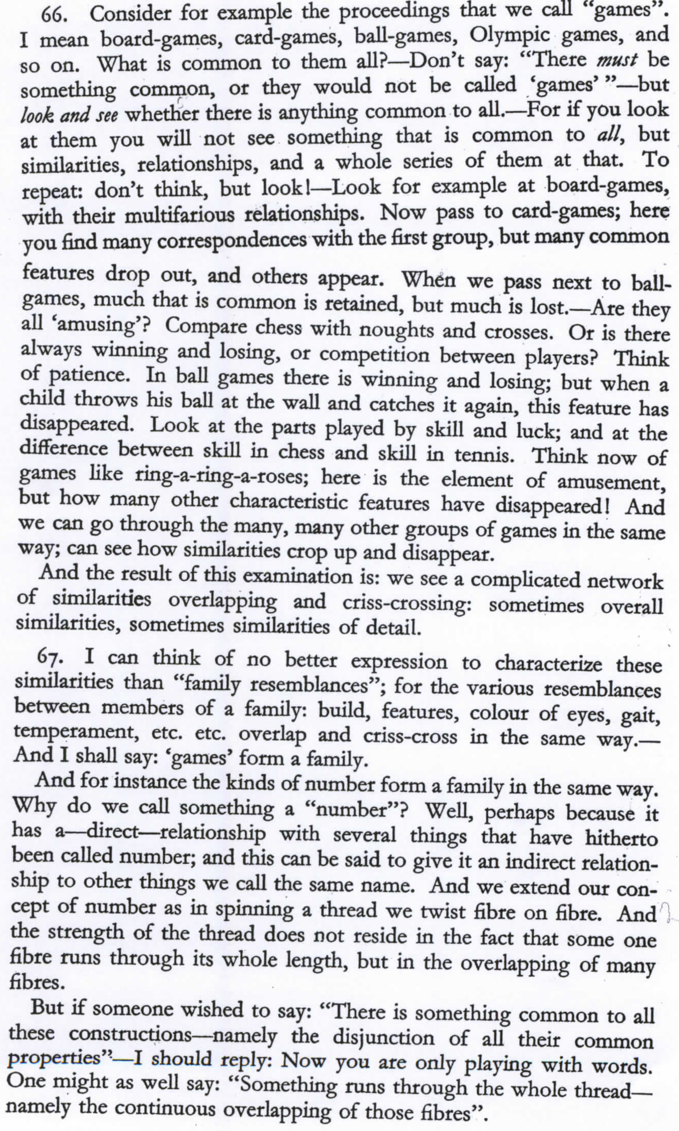
Wittgenstein (1945)
Philosophical
Investigations.
Paragraphs 66,67

Slide 21
What is a game?

Slide 22
Wittgenstein’s thought experiment on "What is a game”:
PI #66:
  ”Don’t say “there must be something common, or they would not be called `games’”—but look and see whether there is anything common to all”
    Is it amusing?
    Is there competition?
    Is there long-term strategy?
    Is skill required?
    Must luck play a role?
    Are there cards?
    Is there a ball?

Slide 23
Family Resemblance
Game 1 | Game 2 | Game 3 | Game 4
ABC | BCD | ACD | ABD
“each item has at least one, and probably several, elements in common with one or more items, but no, or few, elements are common to all items” Rosch and Mervis

Slide 24
How about a radically different approach?

Slide 25
Ludwig Wittgenstein
PI #43:
  "The meaning of a word is its use in the language"

Slide 26
Let's define words by their usages
In particular, words are defined by their environments (the words around them)
Zellig Harris (1954): If A and B have almost identical environments we say that they are synonyms.

Slide 27
What does Ongchoi mean?
Suppose you see these sentences:
  Ongchoi is delicious sautéed with garlic.
  Ongchoi is superb over rice
  Ongchoi leaves with salty sauces
And you've also seen these:
  …spinach sautéed with garlic over rice
  Chard stems and leaves are delicious
  Collard greens and other salty leafy greens
Conclusion:
    Ongchoi is a leafy green like spinach, chard, or collard greens

Slide 28
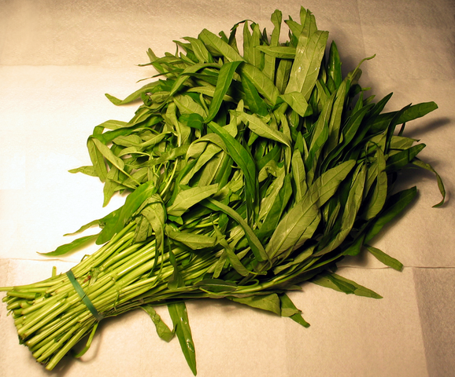
Ongchoi: Ipomoea aquatica
"Water Spinach"
Yamaguchi, Wikimedia Commons, public domain

Slide 29
We'll build a new model of meaning focusing on similarity
Each word = a vector
Similar words are "nearby in space"

Slide 30
We define a word as a vector
Called an "embedding" because it's embedded into a space
The standard way to represent meaning in NLP
Fine-grained model of meaning for similarity
  NLP tasks like sentiment analysis
    With words, requires same word to be in training and test
    With embeddings: ok if similar words occurred!!!
  Question answering, conversational agents, etc.

Slide 31
We'll introduce 2 kinds of embeddings
Tf-idf
  A common baseline model
  Words are represented by a simple function of the counts of nearby words
  Sparse vectors
Word2vec
  Dense vectors
  Representation is created by training a classifier to distinguish nearby and far-away words

Slide 32
Term-document matrix
Each document is represented by a vector of words

Slide 33
Visualizing document vectors

Slide 34
Vectors are the basis of information retrieval
Vectors are similar for the two comedies
As You like It [1,2,37,5],
Twelfth Night [1,2,58,117]
Comedies have more fools and clowns and fewer soldiers and battles.

Slide 35
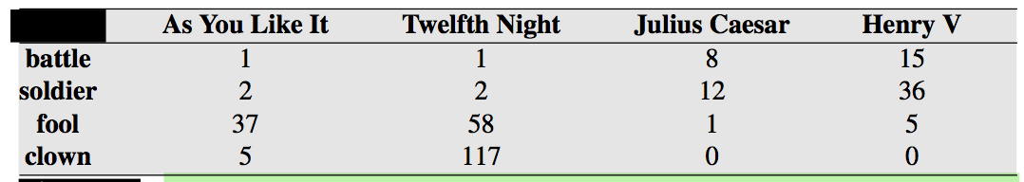
Words can be vectors too
Battle is "the kind of word that occurs in Julius Caesar and Henry V"
Clown is "the kind of word that occurs a lot in Twelfth Night and a bit in As You Like It"

Slide 36
More common: word-word matrix
(or "term-context matrix")
Two words are similar in meaning if their context vectors are similar

Slide 38
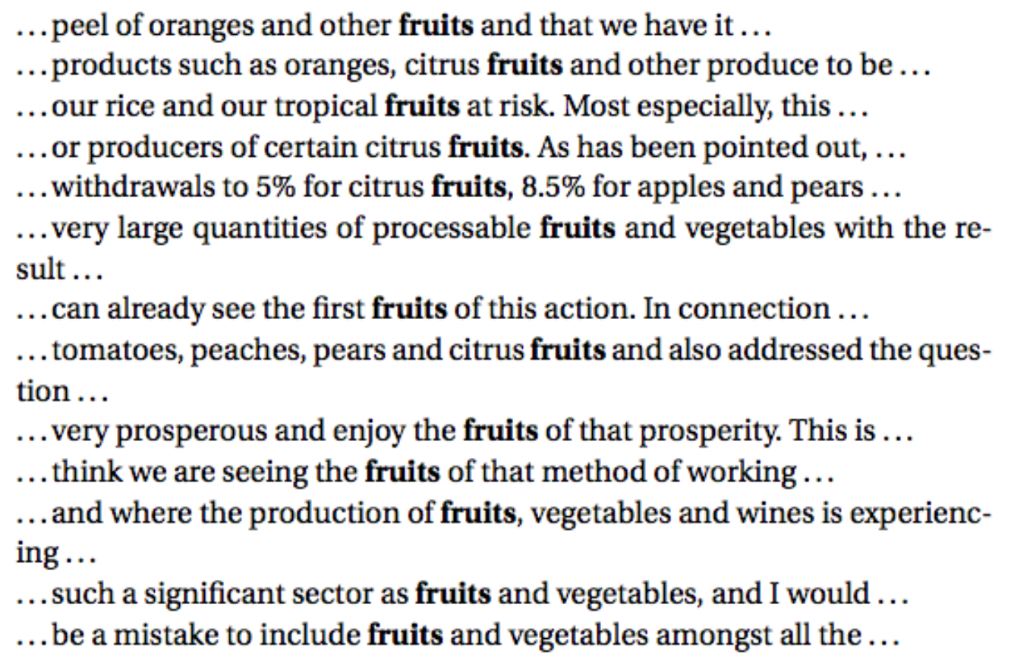
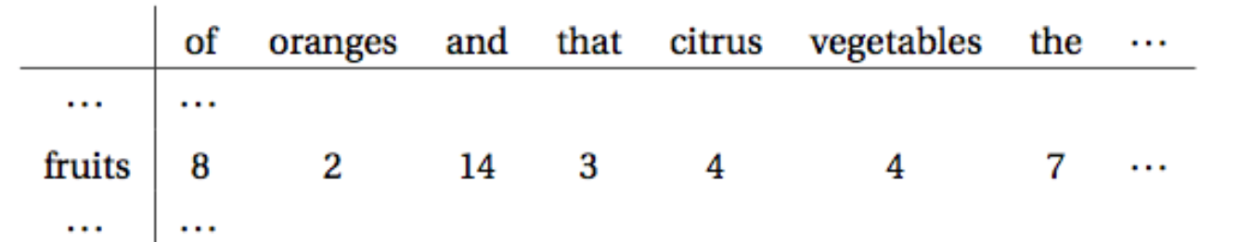
Example from Europarl corpus (Koehn, 2005):

Slide 39
Reminders from linear algebra
vector length

Slide 40
Cosine for computing similarity
Sec. 6.3
v_{i} is the count for word v in context i
w_{i} is the count for word w in context i.
Cos(v,w) is the cosine similarity of v and w
Notes:
See Law of Cosines (Cosine Rule) wikipedia page

Slide 41
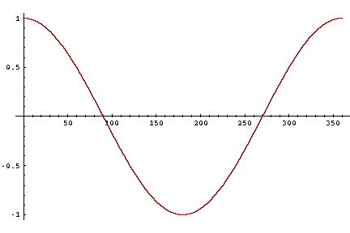
Cosine as a similarity metric
-1: vectors point in opposite directions
+1: vectors point in same directions
0: vectors are orthogonal (right angle, independent)
Frequency is non-negative, so cosine range 0-1

Slide 42
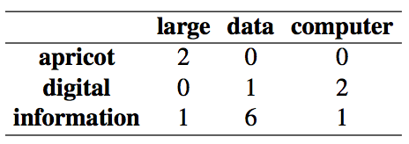
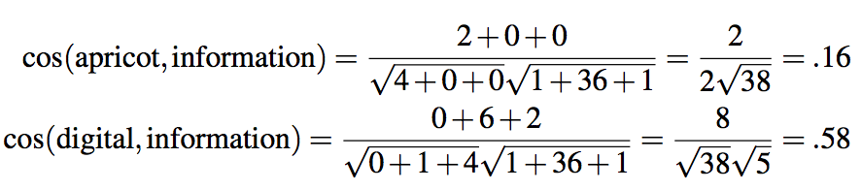
Which pair of words is more similar?
cosine(apricot,information) =
cosine(digital,information) =
cosine(apricot,digital) =
When two vectors are more similar, the cosine is larger but the angle is smaller.

Slide 43
Visualizing cosines (well, angles)
Note that the angle between digital and information is smaller than the angle between apricot and information.

Slide 44
But raw frequency is a bad representation
Frequency is clearly useful; if sugar appears a lot near apricot, that's useful information.
But overly frequent words like the, it, or they are not very informative about the context
Need a function that resolves this frequency paradox!

Slide 45
tf-idf: combine two factors
tf: term frequency. Just raw frequency count (or possible log frequency)
Idf: inverse document frequency:
Total # of docs in collection
Words like "the" have very low idf
# of docs that have word i
tf-idf value for word i in document j:

Slide 46
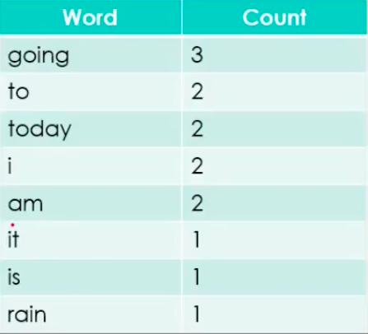
tf-idf: Example
Document 1 It is going to rain today.
Document 2 Today I am not going outside.
Document 3 I am going to watch the season premiere.
Vocabulary of documents

Slide 47
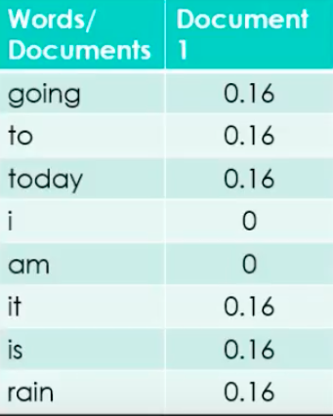
tf-idf: Example
Document 1—
It is going to rain today.
Find it’s TF = (Number of repetitions of word in a document) / (# of words in a document)

Slide 48
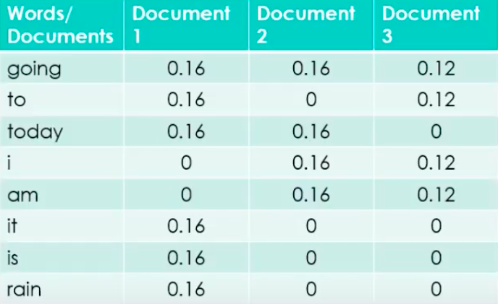
tf-idf: Example
Document 1 It is going to rain today.
Document 2 Today I am not going outside.
Document 3 I am going to watch the season premiere.

Slide 49
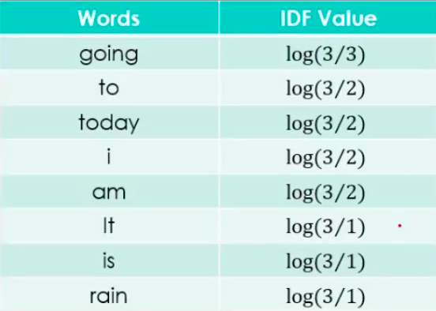
tf-idf: Example
Find IDF for documents (we do this for feature names only/ vocab words which have no stop words )
IDF =Log[(Number of documents) / (Number of documents containing the word)]

Slide 50
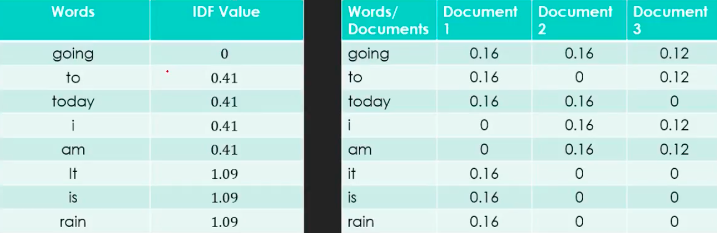
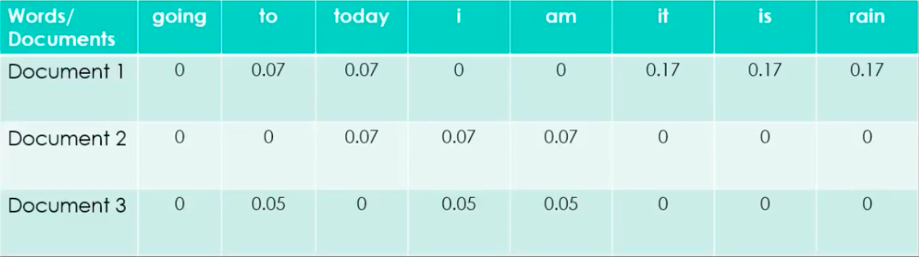
tf-idf: Final TF-IDF = TF * IDF

Slide 51
Summary: tf-idf
Compare two words using tf-idf cosine to see if they are similar
Compare two documents
  Take the centroid of vectors of all the words in the document
  Centroid document vector is:
  Given two documents, we can then compute their document vectors d1 and d2, and estimate the similarity between the two documents by cos(d1,d2).

Slide 52
Applications: tf-idf
  Information retrieval
  Plagiarism detection
  News recommender systems
  And even for digital humanities tasks like comparing different versions of a text to see which are similar to each other.

Slide 53
Tf-idf is a sparse representation
Tf-idf vectors are
  long (length |V|= 20,000 to 50,000)
  sparse (most elements are zero)

Slide 54
Alternative: dense vectors
vectors which are
  short (length 50-1000)
  dense (most elements are non-zero)

Slide 55
Sparse versus dense vectors
Why dense vectors?
  Short vectors may be easier to use as features in machine learning (less weights to tune)
  Dense vectors may generalize better than storing explicit counts
  They may do better at capturing synonymy:
  In practice, they work better

Slide 56
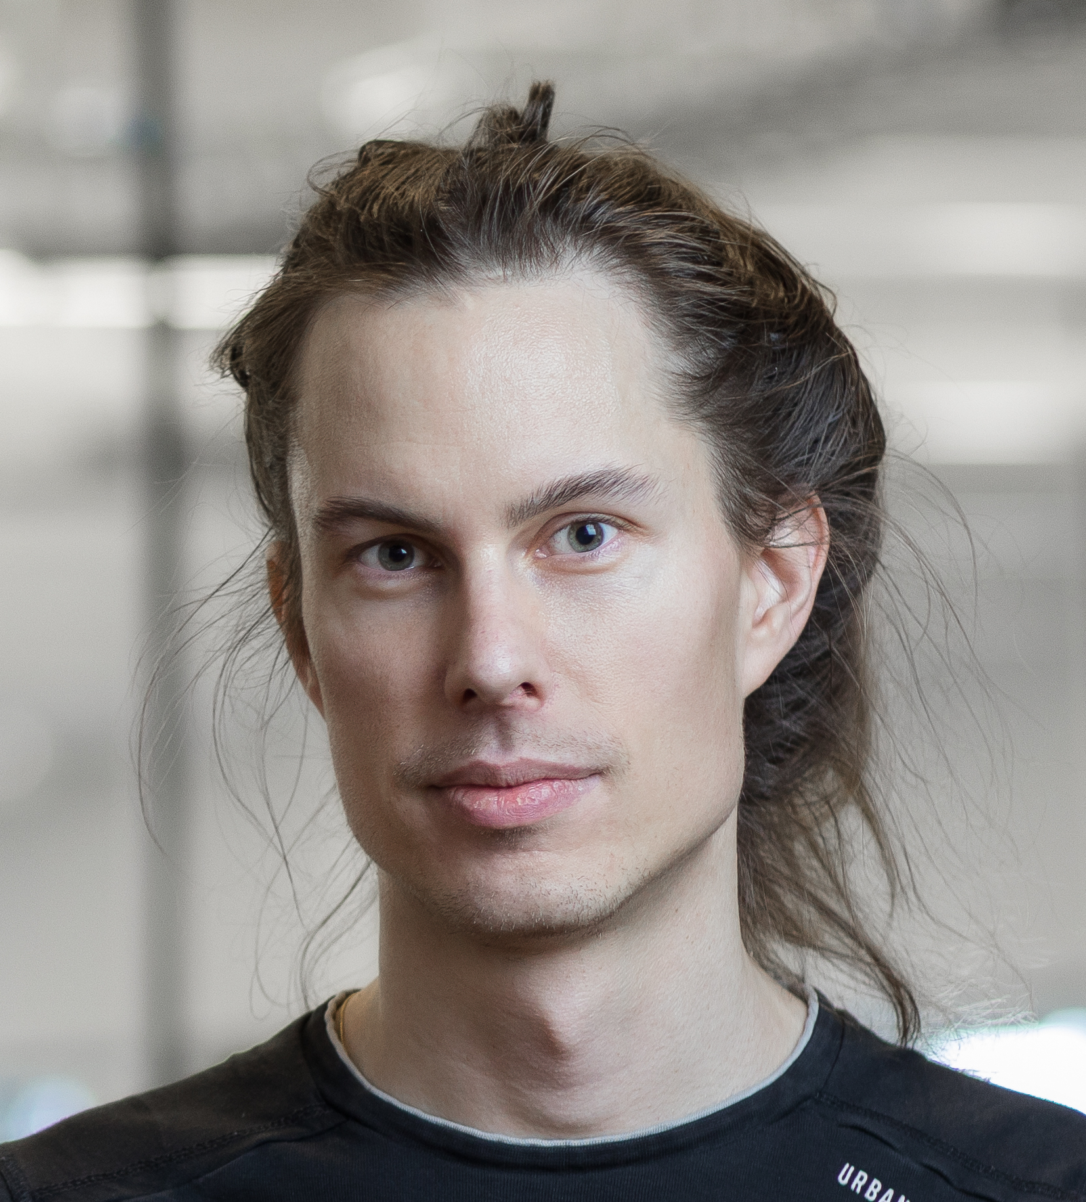

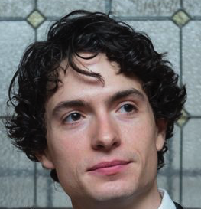
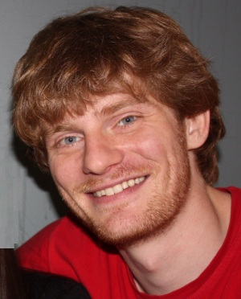
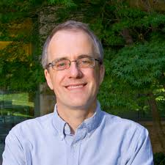
Dense embeddings you can download!
Word2vec (Mikolov et al.)
https://code.google.com/archive/p/word2vec/
Glove (Pennington, Socher, Manning)
http://nlp.stanford.edu/projects/glove/

Slide 57
Word2vec
Idea: predict rather than count
Popular embedding method
Very fast to train
Code available on the web

Slide 58
Word2vec
  Instead of counting how often each word w occurs near "apricot”, train a classifier on a binary prediction task:
    Is w likely to show up near "apricot"?
  We'll take the learned classifier weights as the word embeddings.

Slide 59
Brilliant insight: Use running text as implicitly supervised training data!
A word s near apricot acts as gold ‘correct answer’ to the question “Is word w likely to show up near apricot?”
No need for hand-labeled supervision
The idea comes from neural language modeling
  Bengio et al. (2003)
  Collobert et al. (2011)

Slide 60
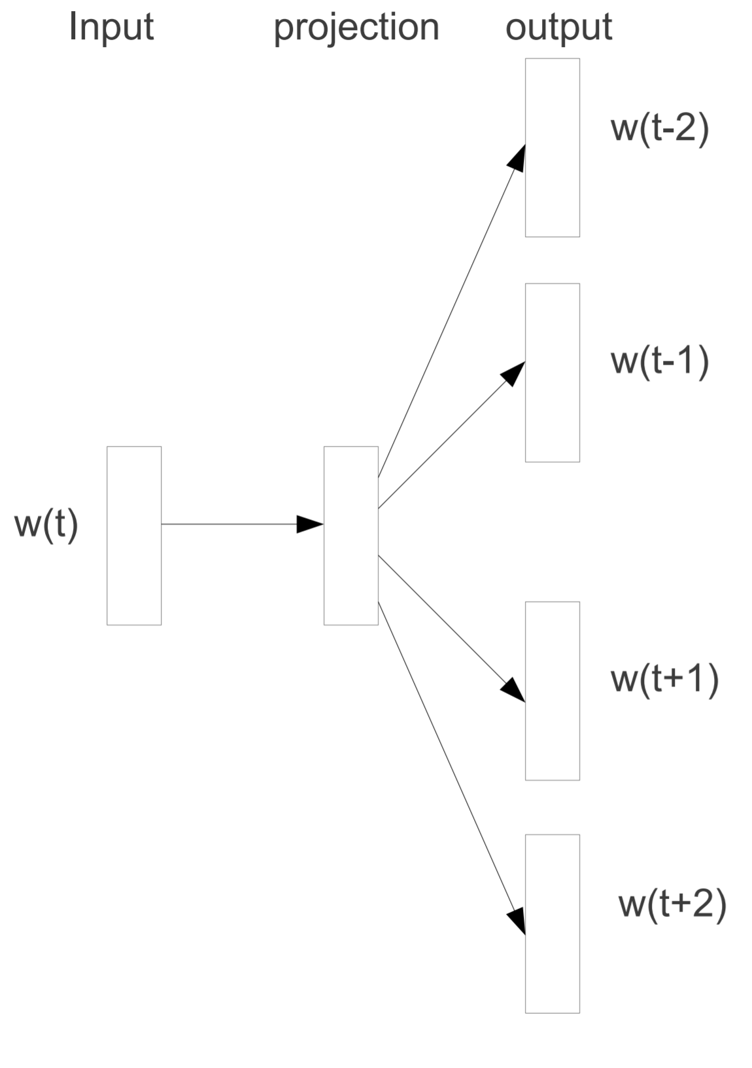
Word2Vec Skip-Gram
  Model attempts to maximize the probability of observing all four context words together, given a center word.
  Skip-gram: works well with small amount of the training data, represents well even rare words or phrases
  CBOW: several times faster to train than the skip-gram, slightly better accuracy for the frequent words
  Skip-Gram model is a better choice most of the time due to its ability to predict infrequent words, but this comes at the price of increased computational cost.

Slide 61
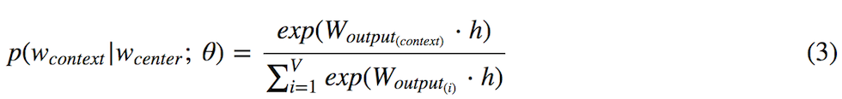
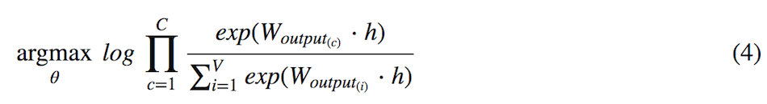
Word2Vec: Derivation of Cost Function
  Maximizing the probability of predicting context words leads to optimizing the weight matrix (θ) that best represents words in a vector space. θ is a concatenation of input and output weight matrices — [W_{input} W_{output}]. Mathematically, it can be expressed as:
  argmax_{θ} p(w₁,w₂,...,w_{C} | w_{center} ;θ) (1)
  where C is the window size, and w is a word vector (which can be a context or a center word)
  argmax_{θ} log p(w₁,w₂,...,w_{C} | w_{center} ;θ) (2)
  In Skip-Gram, following softmax function is used for context words classification.
  W_{output(context)} is a row vector for a context word from the output embedding matrix, and h is the hidden (projection) layer word vector for a center word. Softmax function is then plugged into the eq (2) to yield a new objective function that maximizes the probability of observing all C context words, given a center word:

Slide 62
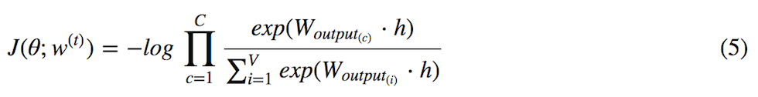
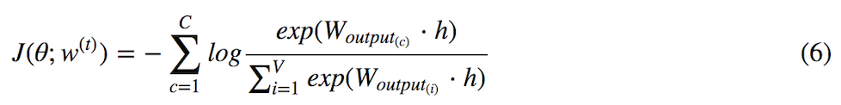
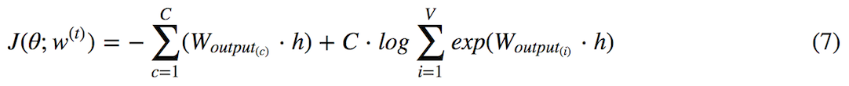
Word2Vec: Derivation of Cost Function
  However, in machine learning, the convention is to minimize the cost function, not to maximize it. To stick to the convention, we add a negative sign to eq (4). This can be done because minimizing a negative log-likelihood is equivalent to maximizing a positive log-likelihood. Therefore, the cost function we want to minimize becomes:
  where c is the index of the context word around the center word (wt). t is the index of the center word within a corpus of size T. Using the property of log, it can be changed to:
  Different paper uses different notations for the cost function. To stick to the notation used in the Word2Vec original paper, some of the notations in eq (7) can be changed. However, they are all equivalent:

Slide 63
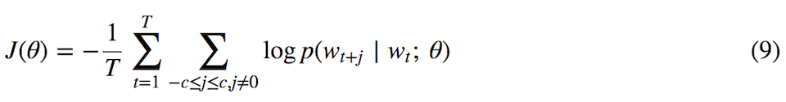
Word2Vec: Derivation of Cost Function
  Note that eq (7) and eq (8) are equivalent. They both assume stochastic gradient descent, which means that for each training sample (center word) w(t) in the corpus of size T, one update is made to the weight matrix (θ). The cost function expressed in the paper shows batch gradient descent eq (9), which means that only one update is made for all T training samples:
  In Word2Vec, batch gradient descent is almost never used due to its high computational cost. However, the author of the paper stated that he used stochastic gradient descent for training.

Slide 64
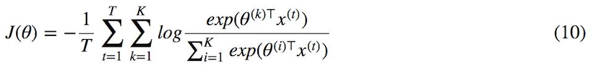
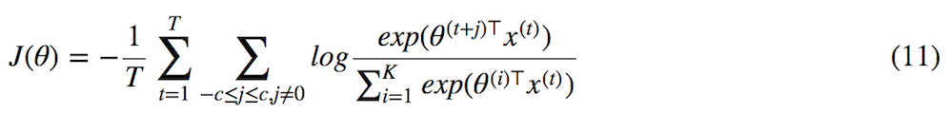
Word2Vec: Window Size of Skip-Gram
  A general form of the softmax regression looks like this:
  where T is the number of training samples, and K is the number of labels to classify. In NLP applications, K=V, because there are V unique vocabulary we need to classify in a vector space. V can easily exceed tens of thousands. Skip-Gram tweaks this a little, and replaces K with a variable called window size C.
  Thus, the adapted form of the softmax regression equation for Skip-Gram becomes:
  This is equivalent to eq (9). Note that the K in the denominator is still equal to V, because the denominator acts as a normalization factor. However, the size of K in the denominator can still be reduced to smaller size using negative sampling.

Slide 65
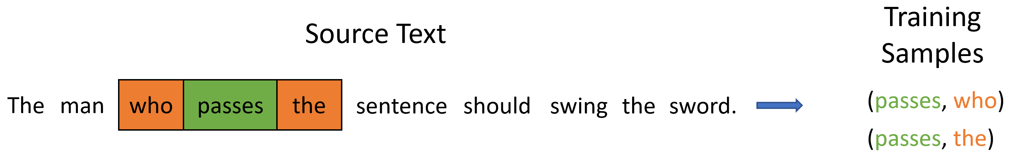
Word2Vec: Neural Network Structure of Skip-Gram
  How is neural network used to minimize the cost functoin described in eq (11)? One needs to look into the structure of the Skip-Gram model to gain insights about their correlation.
  For illustration purpose, let's assume that the entire corpus is composed of the quote from the Game of Thrones, "The man who passes the sentence should swing the sword", by Ned Stark. There are 10 words (T=10), and 8 unique words (V=8).
  We will use window=1, and assume that 'passes' is the current center word, making 'who' and 'the' context words.
  For illustration purpose, a three-dimensional neural net will be constructed by setting size=3. This makes N=3. This means that the input weight matrix (Winput) will have a size of 8×3, and output weight matrix (WToutput) will have a size of 3×8.

Slide 66
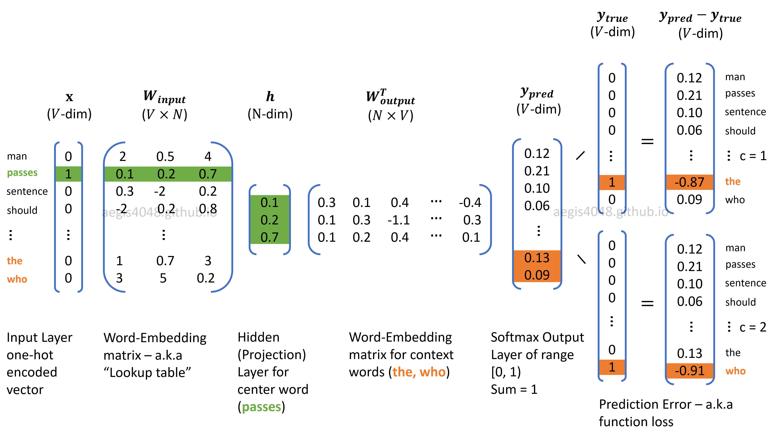
Word2Vec: Neural Network Structure of Skip-Gram

Slide 67
Word2Vec: Training: Forward Propagation
  The word embedding matrices (W_{input}, W_{output}) in Skip-Gram are optimized through forward and backward propagations.
  Forward propagation includes obtaining the probability distribution of words (y_{pred}) given a center word, and backward propagation includes calculating the prediction error, and updating the weight (embedding) matrices to minimize the prediction error.
Input Layer (x)
  The input layer is a V-dim one-hot encoded vector. Every element in the vector is 0 except one element that corresponds to the center (input) word. Input vector is multiplied with the input weight matrix (Winput) of size V×N, and yields a hidden (projection) layer (h) of N-dim vector. Because the input layer is one-hot encoded, it makes the input weight matrix (Winput) to behave like a look-up table for the center word.

Slide 68
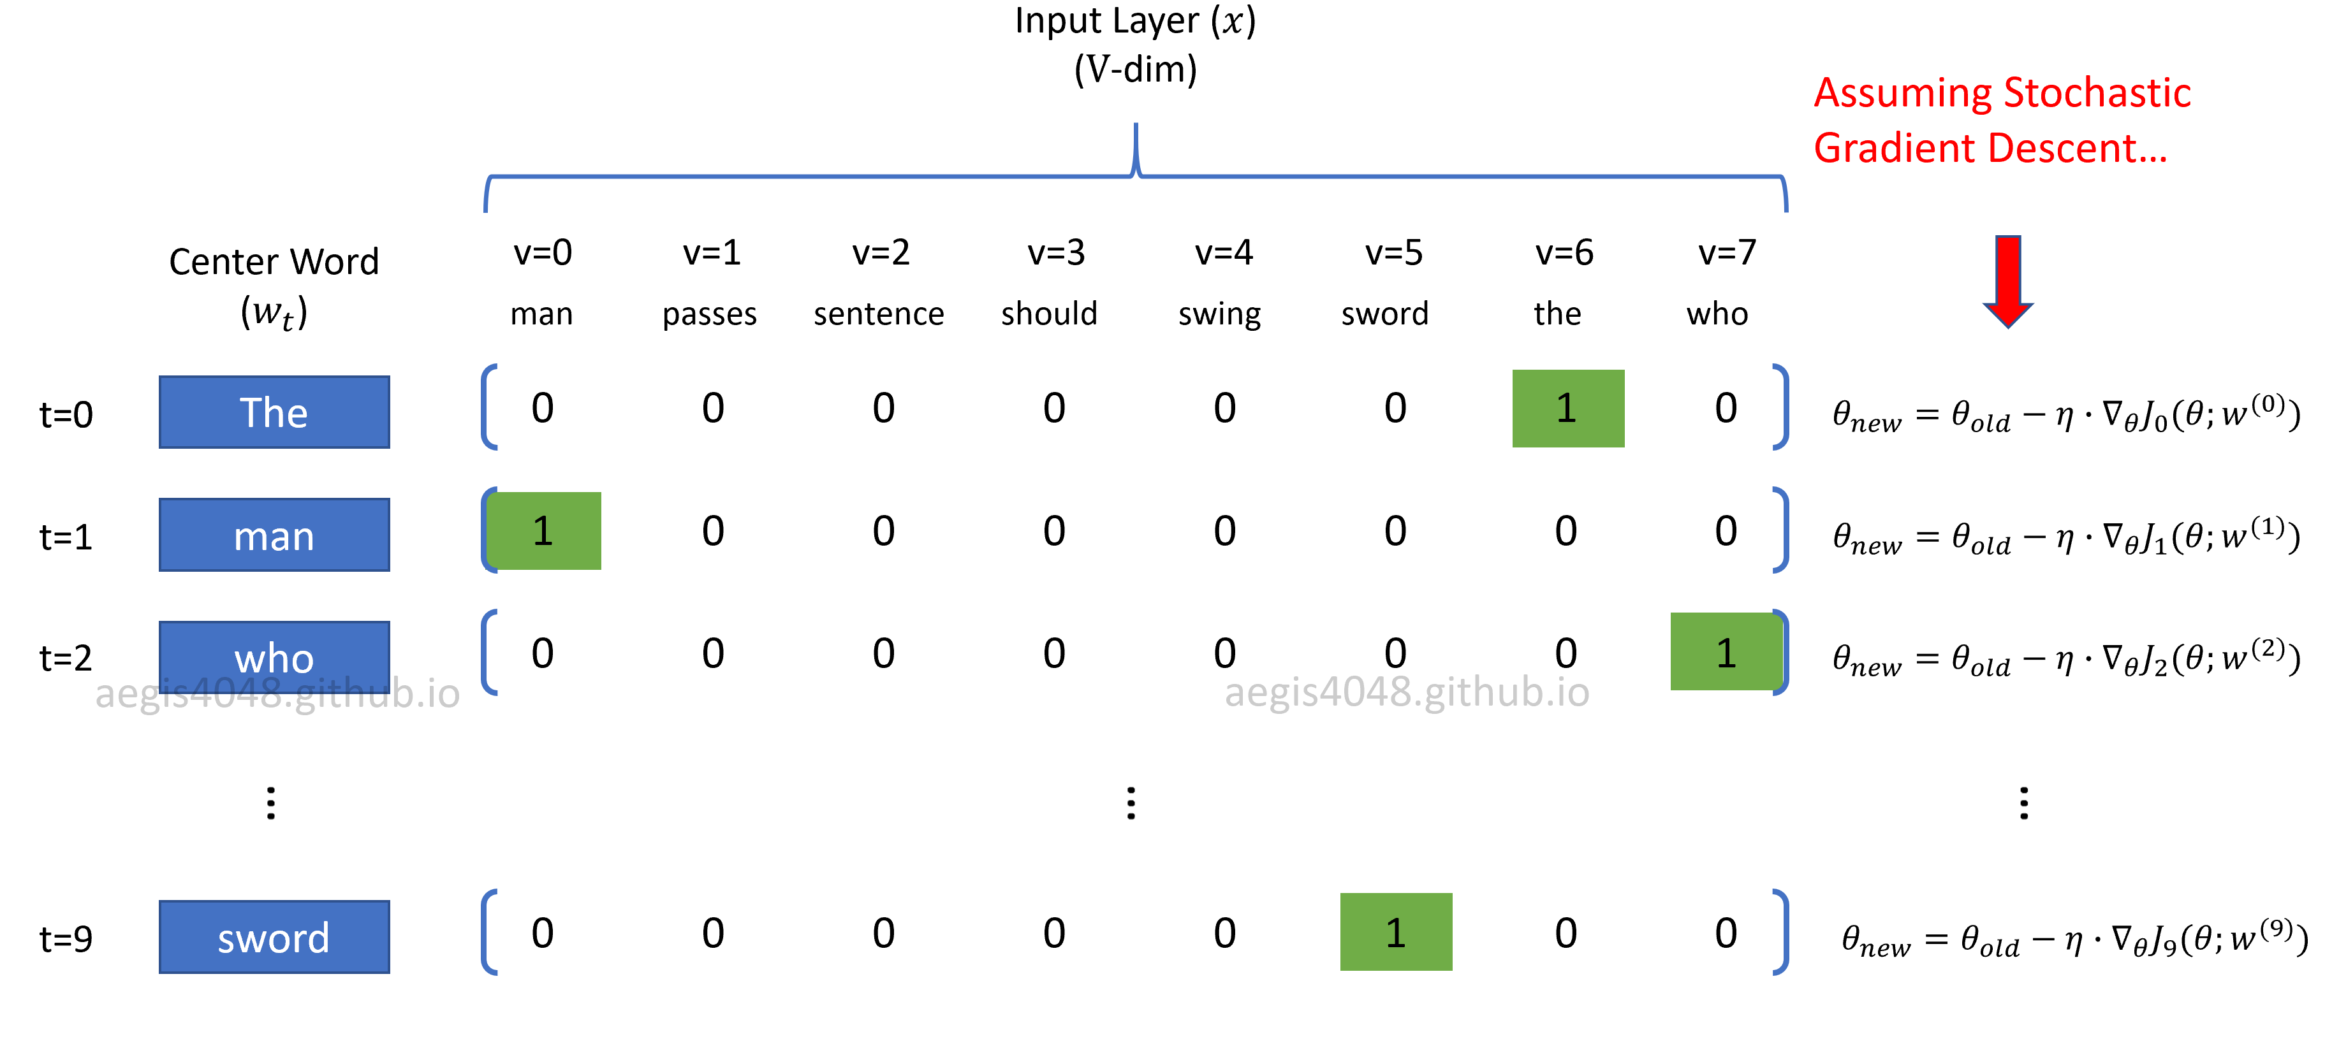
Word2Vec: Training: Forward Propagation
Input Layer (x)
  η is learning rate, ∇J(θ) is gradient for the weight matrix, and J(θ) is the cost function that has different forms for each model.

Slide 69
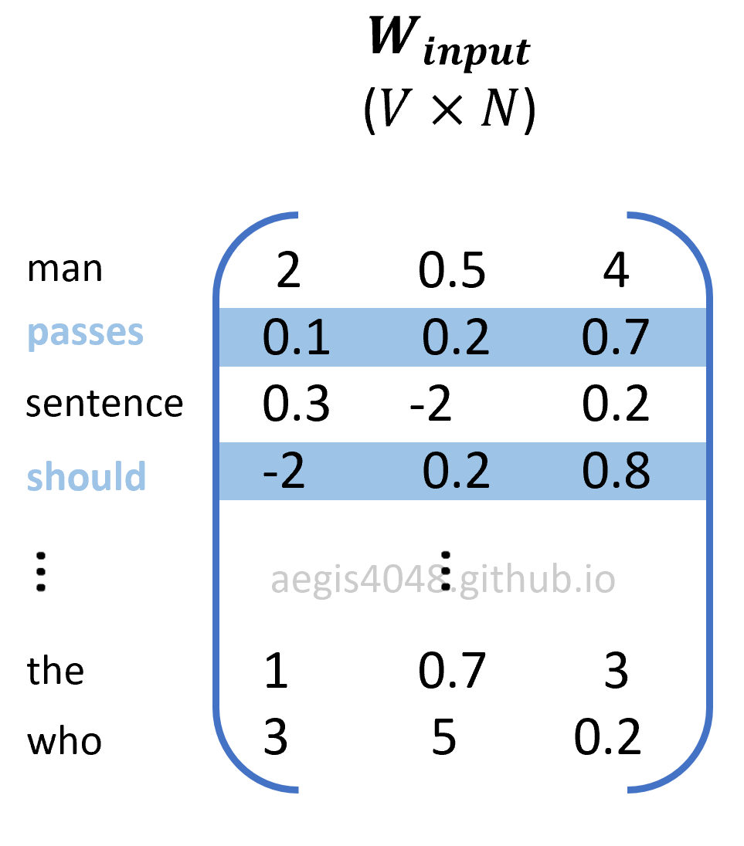
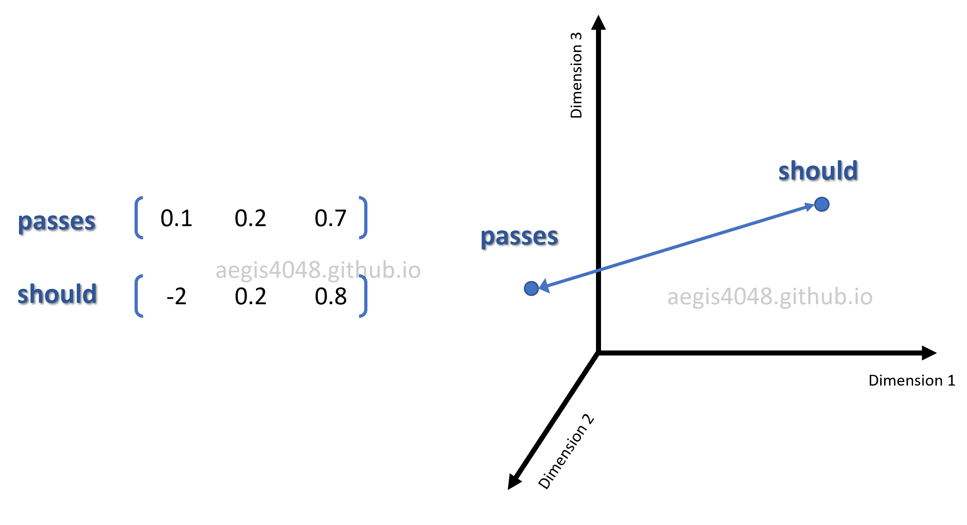
Word2Vec: Training: Forward Propagation
  Input and Output Weight Matrix (W_{input}, W_{output})
  In fact, the ultimate goal of the model is not to predict context words, but to construct the word embedding matrices (Winput, Woutput) that best capture relationship among words in a vector space.
  Skip-Gram achieves this by using a neural net — it optimizes the weight (embedding) matrices by adjusting the weight matrix to minimize the prediction error (ypred−ytrue).
  Each row in a word-embedding matrix is a word-vector for each word. Consider the following word-embedding matrix, Winput.. Since we set the size of the weight matrix to be size=3 above, the matrix is three-dimensional, and can be visualized in a 3D vector space:

Slide 70
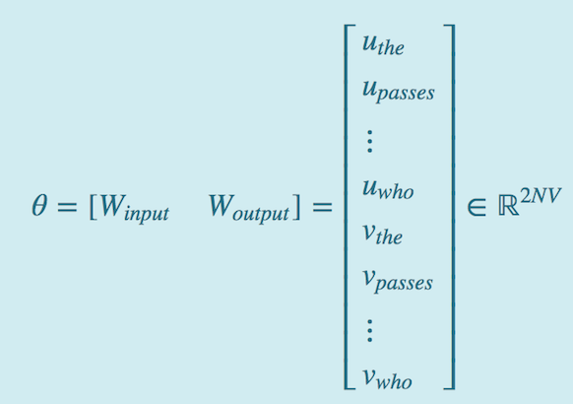
Word2Vec: Training: Forward Propagation
Input and Output Weight Matrix (W_{input}, W_{output})
  There are two weight matrices that need to be optimized in Skip-Gram model: Winput and Woutput. Often times in neural net, the weights are expressed as θ.
  In Skip-Gram, θ is a concatenation of input and output weight matrices — [Winput Woutput].
  θ has a size of 2V×N, where V is the number of unique vocab in a corpus, and N is the dimension of word vectors in the embedding matrices. 2 is multipled to V because there are two weight matrices, Winput and Woutput. u is a word vector from Winput and v is a word vector from Woutput. Each word vectors are N-dim row vectors from input and output embedding matrices.

Slide 71
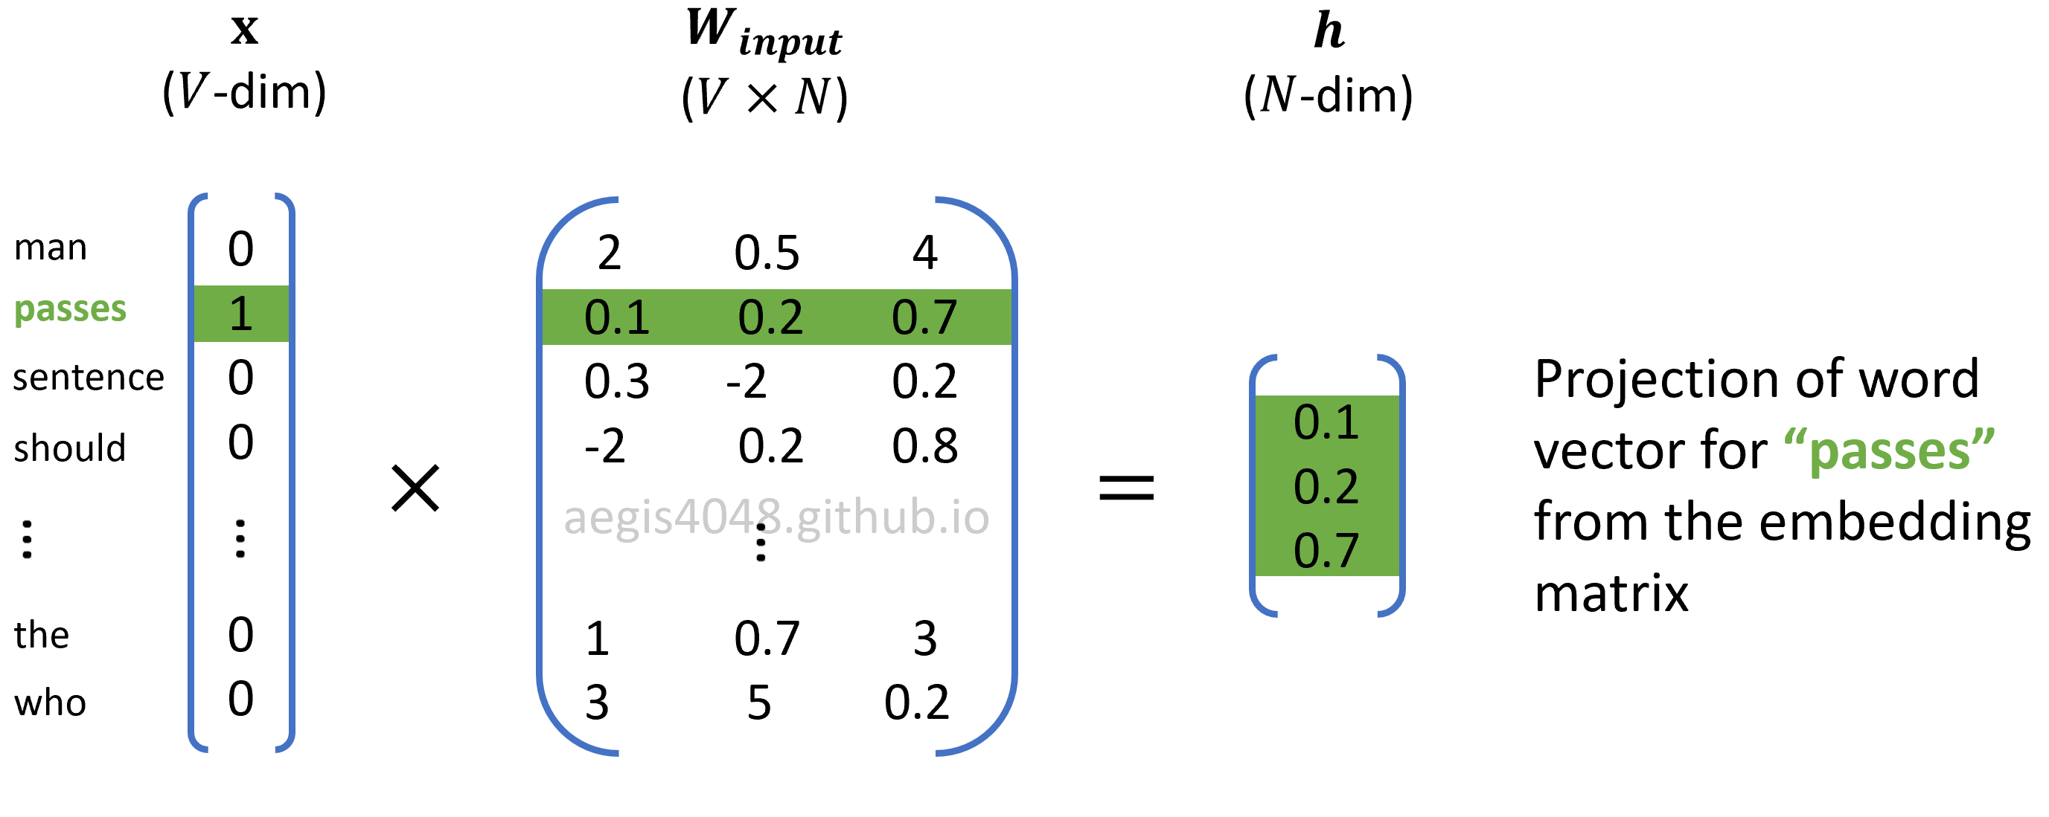
Word2Vec: Training: Forward Propagation
Hidden (Projection) Layer (h)
  Skip-Gram uses a neural net with one hidden layer. In the context of natural language processing, hidden layer is often referred to as a projection layer, because h is essentially an 1D vector projected by the one-hot encoded input vector.
  h is obtained by multiplying the input word embedding matrix with the V-dim input vector.

Slide 72
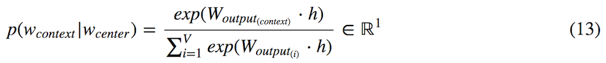
Word2Vec: Training: Forward Propagation
Softmax Output Layer (ypred)
  The output layer is a V-dim probability distribution of all unique words in the corpus, given a center word. In statistics, the conditional probability of A given B is denoted as p(A|B). In Skip-Gram, we use the notation, p(wcontext|wcenter), to denote the conditional probability of observing a context word given a center word. It is obtained by using the softmax function,
  where Woutput(i) is the i-th row vector of size 1×N from the output embedding matrix, Woutputcontext is also a row vector of size 1×N from the output embedding matrix corresponding to the context word. V is the size of unique vocab in the corpus, and h is the hidden (projection) layer of size (N×1). The output is an 1×1 scalar value of probability of range [0,1).
  This probability is computed V times to obtain a conditional probability distribution of observing each unique vocabs in the corpus, given a center word.

Slide 73
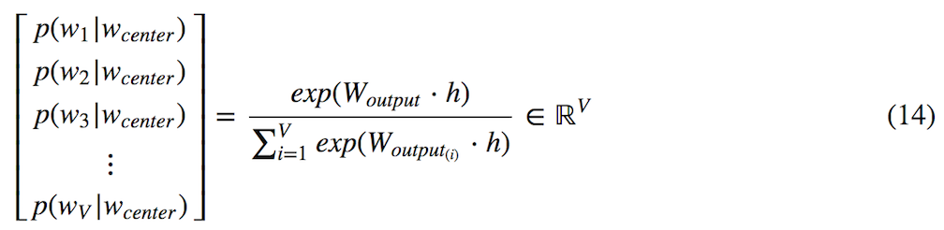
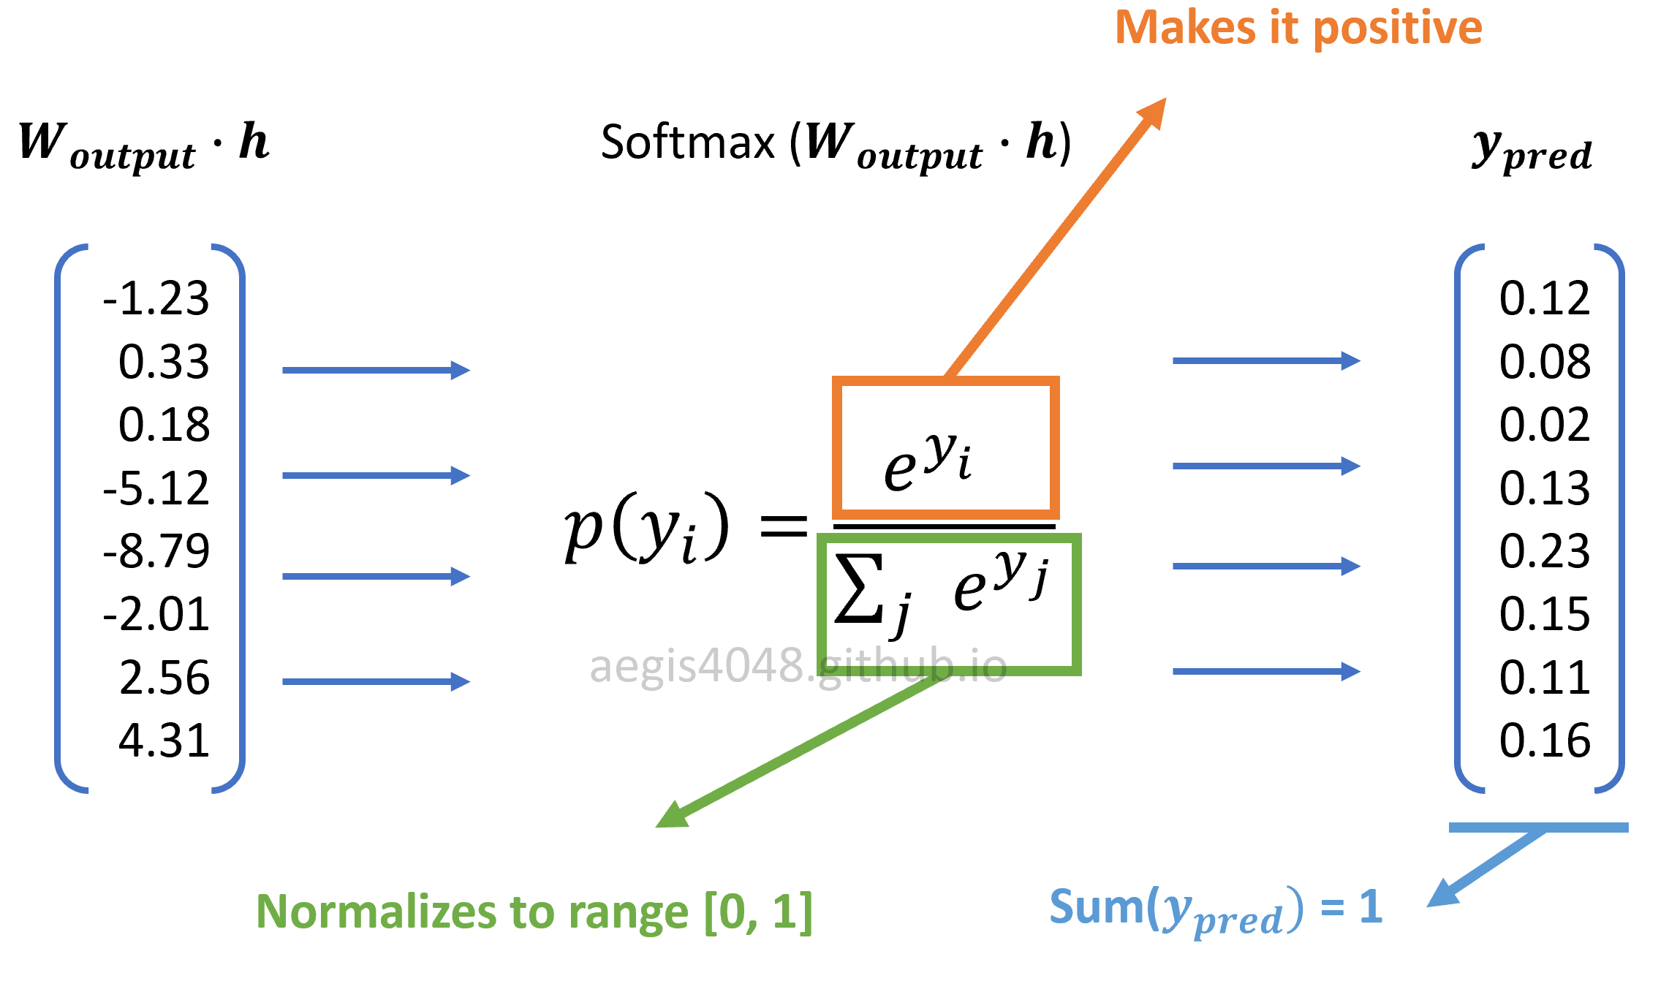
Word2Vec: Training: Forward Propagation
Softmax Output Layer (ypred)
  Woutput in the denominator of eq 13 has size V×N. Multiplying Woutput with h of size N×1 will yield a dot product vector of size V×1. This dot product vector goes through the softmax function:

Slide 74
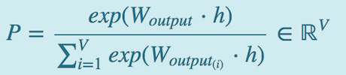
Word2Vec: Training: Forward Propagation
Softmax Output Layer (ypred)
  The exponentiation ensures that the transformed values are positive, and the normalization factor in the denominator ensures that the values have a range of [0,1). The result is a conditional probability distribution of observing each unique vocabs in the corpus, given a center word.
Negative Sampling
  Softmax function in Skip-Gram has the following equation:
  There is an issue with softmax in Skip-Gram — it is computationally very expensive, as it requires scanning through the entire output embedding matrix (Woutput) to compute the probability distribution of all V words, where V can be millions or more. Furtheremore, the normalization factor in the denominator also requires V iterations. When implemented in codes, the normalization factor is computed only once and cached as a Python variable, making the alogrithm complexity = O(V+V)≈O(V).

Slide 75
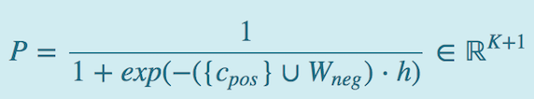
Word2Vec: Training: Forward Propagation
Negative Sampling
  Due to this computational inefficiency, softmax is not used in most implementaions of Skip-Gram. Instead we use an alternative called negative sampling with sigmoid function, which rephrases the problem into a set of independent binary classification task of algorithm complexity = O(K+1), where K typically has a range of [5,20]. Then, the new probability distribution is defined as:
  K=20 is used for small corpus, and K=5 is used for big corpus. Negative sampling is much cheaper than vanilla Skip-Gram with softmax, because K is between 5 ~ 20, whereas V can be millions. Moreover, no extra iterations are necessary to compute the normalization factor in the denominator, because sigmoid function is a binary regression classifier. The algorithm complexity of the probability distribution of vanilla Skip-Gram is O(V), whereas negative sampling's is O(K+1). This shows why negative sampling saves a significant amount of computational cost per iteration.

Slide 76
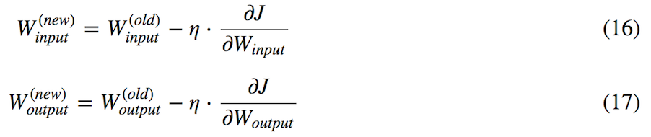
Word2Vec: Training: Backward Propagation
  Backward propagation involves computing prediction errors, and updating the weight matrix (θ) to optimize vector representation of words. Assuming stochastic gradient descent, we have the following general update equations for the weight matrix (θ):
  η is learning rate, ∇J(θ;w(t)) is gradient for the weight matrix, and J(θ;w(t)) is the cost function defined in eq (6). Since the θ is a concatenation of input and output weight matrices ([WinputWoutput]) as described above, there are two update equations for each embedding matrix:
  Mathematically, it can be shown that the gradients of Winput Woutput have the following forms:

Slide 77
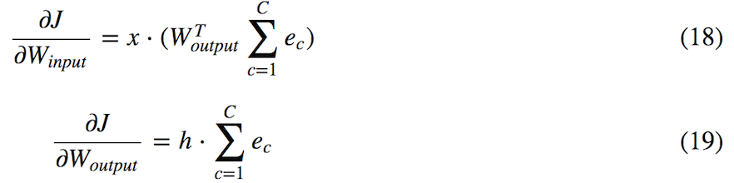
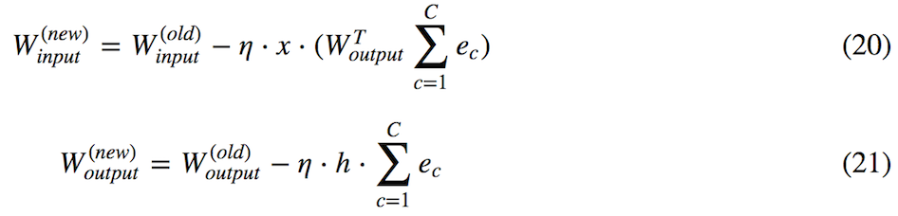
Word2Vec: Training: Backward Propagation
  The gradients can be substituted into eq (16) and eq (17):
  Winput is input weight matrix, Woutput is output weight matrix, x is one-hot encoded input layer, C is window size, and ec is prediction error for c-th context word in the window. Note that h (hidden layer) is equivalent to WTinputx.

Slide 78
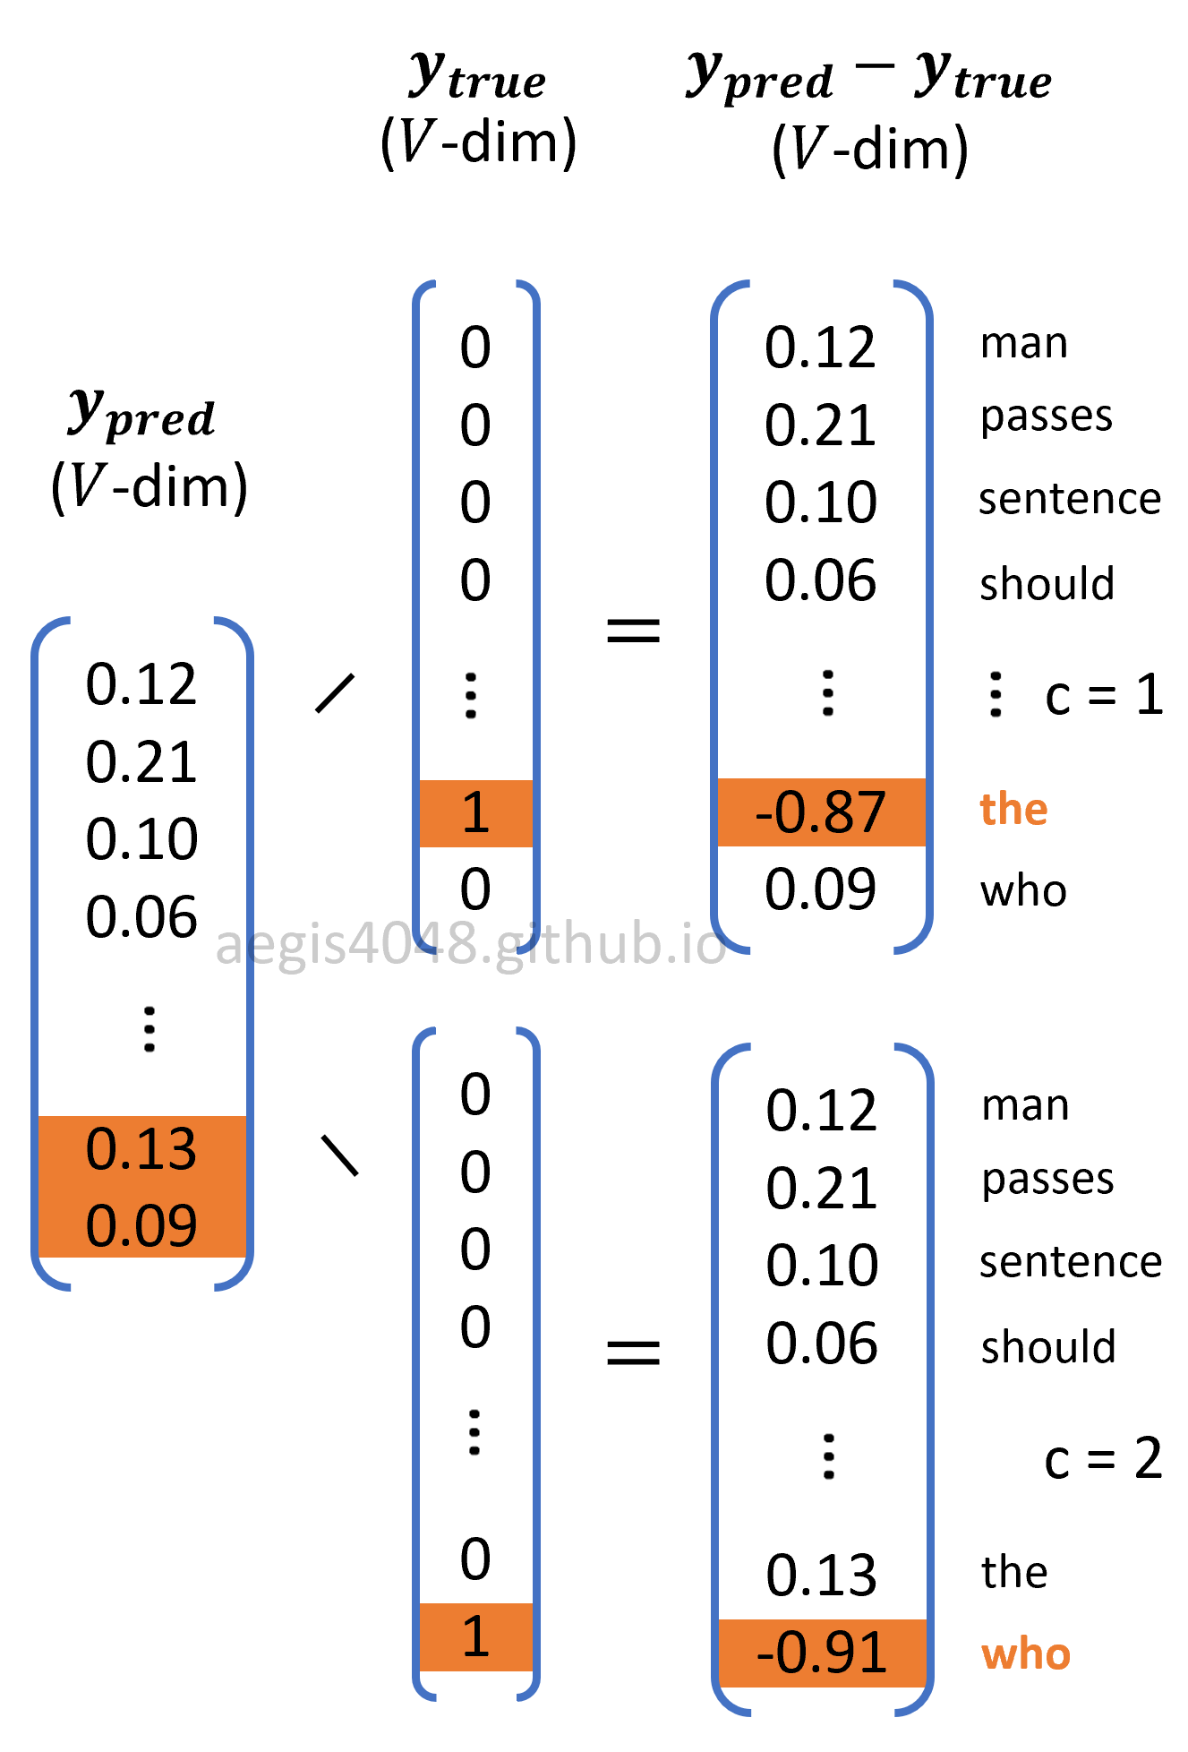
Word2Vec: Training: Backward Propagation
  Although eq (21) does not explicitly show it, softmax function is applied in the prediction error (ec). Prediction error is the difference between the predicted and true probability (ypred−ytrue) as illustrated next. The predicted probability ypred is computed using softmax function using eq (13).
Prediction Error (ypred−ytrue)
  Skip-Gram model optimizes the weight matrix (θ) to reduce the prediction error. Prediction error is the difference between the probability distribution of words computed from the softmax output layer (ypred) and the true probability distribution (ytrue) of the c-th context word. Just like the input layer, ytrue is one-hot encoded vector, in which only one element in the vector that corresponds to the c-th context word is 1, and the rest is all 0.

Slide 79
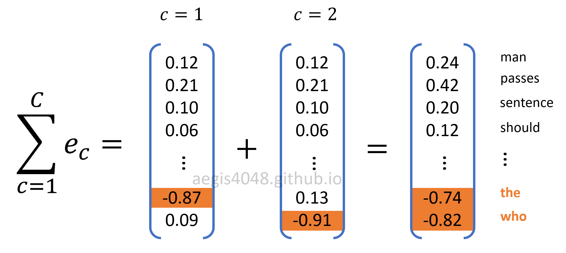
Word2Vec: Training: Backward Propagation
Prediction Error (ypred−ytrue)
  Prediction errors for all C context words are summed up to compute weight gradients to update weight matrices.

Slide 80
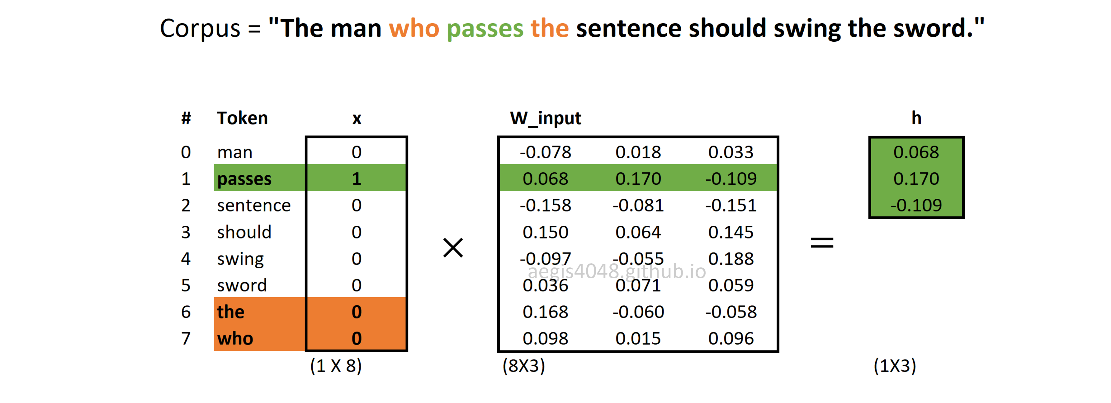
Word2Vec: Numerical Example
Screenshots are used to demonstrate the concept of updating weight matrices through forward and backward propagations.
Forward Propagation: Computing hidden (projection) layer
  Center word is "passes". Window size is size=1, making "the" and "who" context words. Hidden layer (h) is looked up from the input weight matrix. It is computed with eq (12).

Slide 81
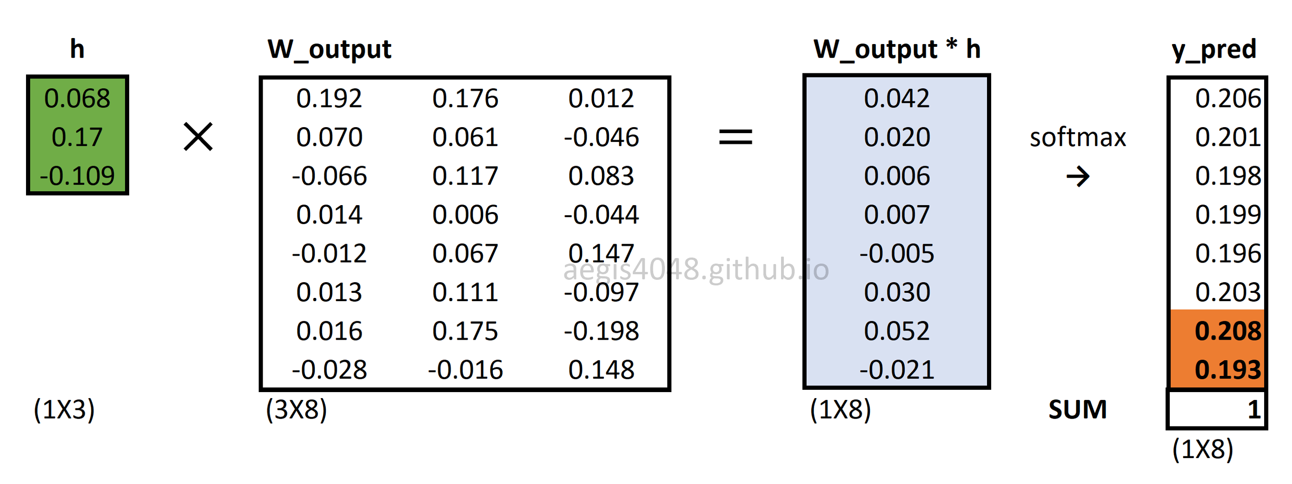
Word2Vec: Numerical Example
Forward Propagation: Softmax output layer
  Output layer is a probability distribution of all words, given a center word. It is computed with eq (14). Note that all context windows share the same output layer (ypred). Only the errors (ec) are different.

Slide 82
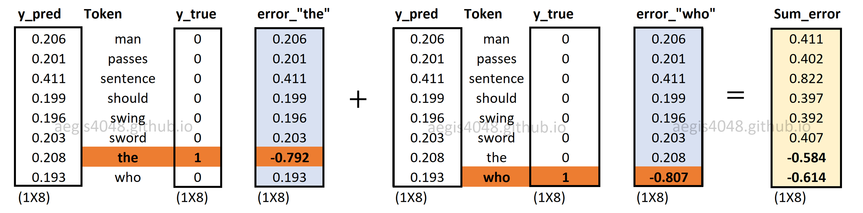
Word2Vec: Numerical Example
Backward Propagation: Sum of Prediction Errors
  C different prediction errors are computed, then summed up. In this case, since we set window=1 above, only two errors are computed.

Slide 83
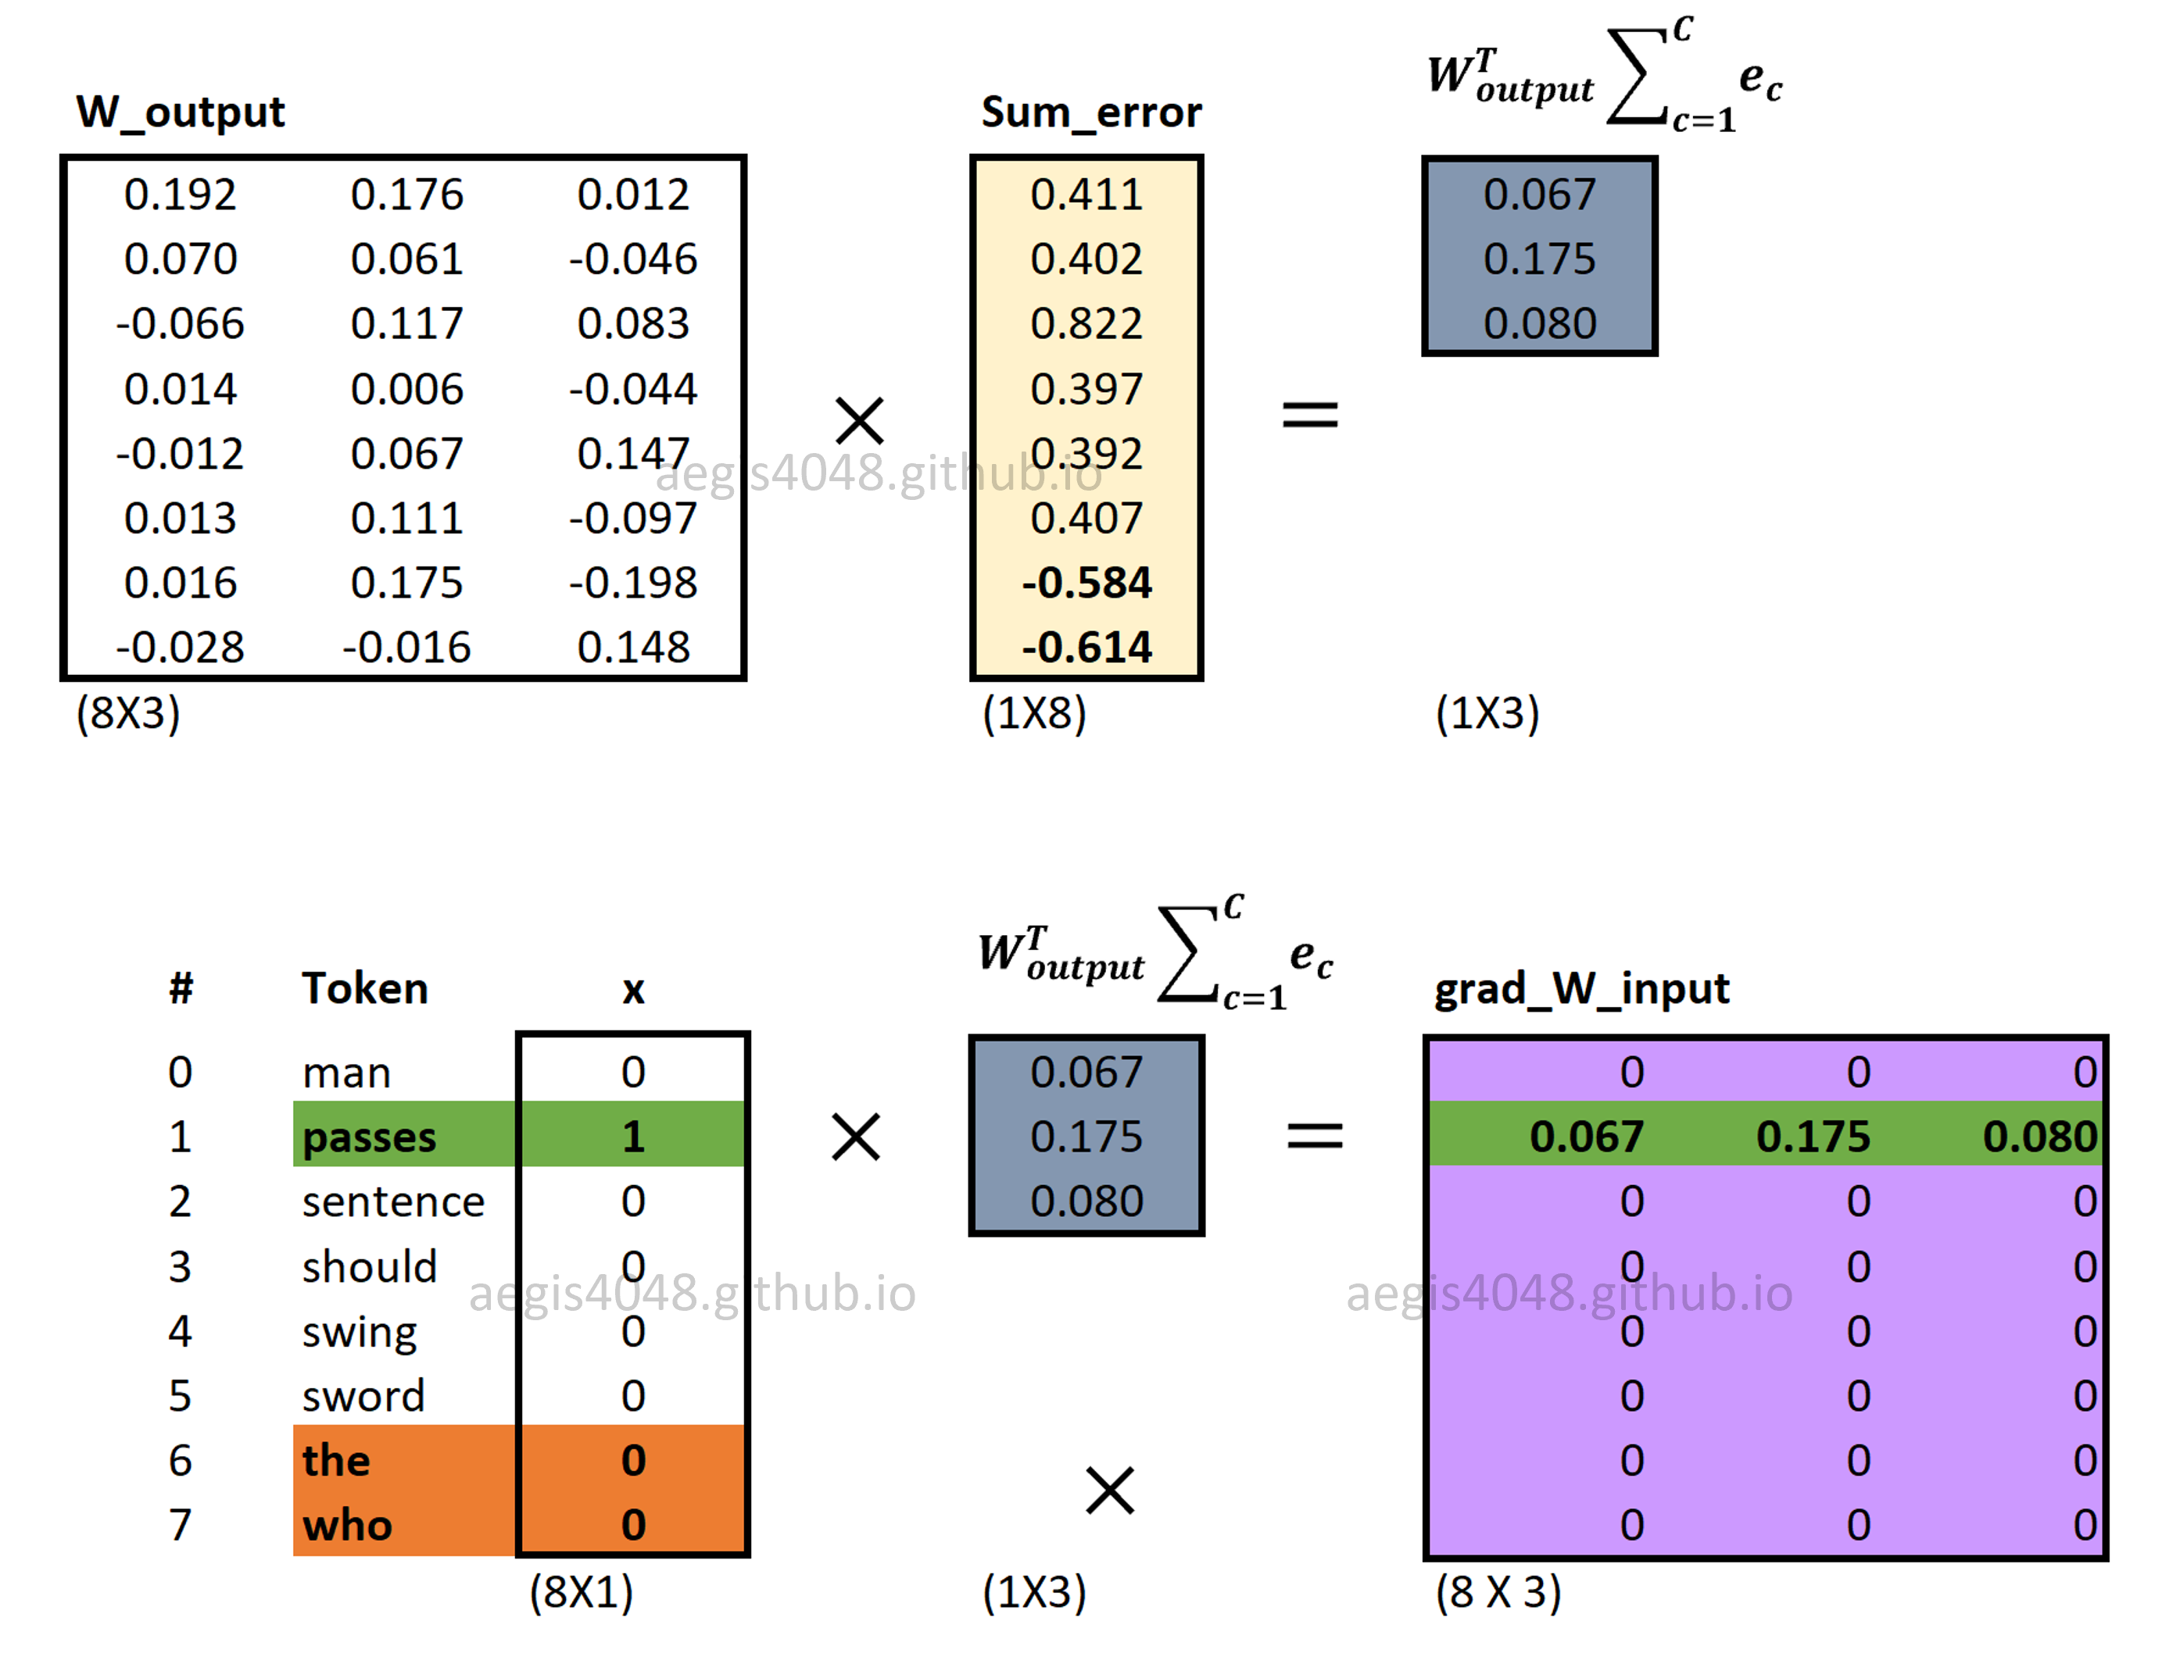
Word2Vec: Numerical Example
Backward Propagation: Computing ∇Winput
  Gradients of input weight matrix (∂J∂Winput) are computed using eq (18). Note that multiplying WToutput∑Cc=1ec with the one-hot-encoded input vector (x) makes the neural net to update only one word vector that corresponds to the input (center) word.

Slide 84

Word2Vec: Numerical Example
Backward Propagation: Computing ∇Woutput
  Gradients of output weight matrix (∂J∂Woutput) are computed using eq (19). Unlike the input weight matrix (Winput), all word vectors in the output weight matrix (Woutput) are updated.

Slide 85


Word2Vec: Numerical Example
Backward Propagation: Updating Weight matrices
  Input and output weight matrices ([WinputWoutput]) are updated using eq (20) and eq (21).

Slide 86
Evaluating embeddings
Compare to human scores on word similarity-type tasks:
WordSim-353 (Finkelstein et al., 2002)
SimLex-999 (Hill et al., 2015)
Stanford Contextual Word Similarity (SCWS) dataset (Huang et al., 2012)
TOEFL dataset: Levied is closest in meaning to: imposed, believed, requested, correlated

Slide 87
Properties of embeddings
Similarity depends on window size C
C = ±2 The nearest words to Hogwarts (school of witchcraft in Harry Potter series):
  Sunnydale (School for drama The Buffy the vampire Slayer)
  Evernight (School for Vampire series)
C = ±5 The nearest words to Hogwarts:
  Dumbledore (Character: Albus Dumbledore in Harry Potter)
  Malfoy (Character: Draco Malfoy in Harry Potter)
  Halfblood (Character: Half-blood Harry Potter is the son of a pure-blood wizard and a Muggle-born witch)

Slide 88


Analogy: Embeddings capture relational meaning!
vector(‘king’) - vector(‘man’) + vector(‘woman’) $≈$vector(‘queen’)
vector(‘Paris’) - vector(‘France’) + vector(‘Italy’) $≈$ vector(‘Rome’)
(Hamilton et al., 2016)

Slide 89

(Pennington et al., 2014)

Slide 90

(Pennington et al., 2014)

Slide 91

Embeddings can help study word history!
Train embeddings on old books to study changes in word meaning!!
Will Hamilton

Slide 92





Diachronic (evolution) word embeddings for studying language change!
Word vectors for 1920
Word vectors 1990
“dog” 1990 word vector
“dog” 1920 word vector
vs.
1900
1950
2000
￼
￼

Slide 93

Visualizing changes
~30 million books, 1850-1990, Google Books data

Slide 94
Embeddings reflect cultural bias
Bolukbasi, Tolga, Kai-Wei Chang, James Y. Zou, Venkatesh Saligrama, and Adam T. Kalai. "Man is to computer programmer as woman is to homemaker? debiasing word embeddings." In Advances in Neural Information Processing Systems, pp. 4349-4357. 2016.
Ask “Paris : France :: Tokyo : x”
  x = Japan
Ask “father : doctor :: mother : x”
  x = nurse
Ask “man : computer programmer :: woman : x”
  x = homemaker

Slide 95
Embeddings reflect cultural bias
Caliskan, Aylin, Joanna J. Bruson and Arvind Narayanan. 2017. Semantics derived automatically from language corpora contain human-like biases. Science 356:6334, 183-186.
Implicit Association test (Greenwald et al 1998): How associated are
  concepts (flowers, insects) & attributes (pleasantness, unpleasantness)?
  Studied by measuring timing latencies for categorization.
Psychological findings on US participants:
  African-American names are associated with unpleasant words (more than European-American names)
  Male names associated more with math, female names with arts
  Old people's names with unpleasant words, young people with pleasant words.
Caliskan et al. replication with embeddings:
  African-American names (Leroy, Shaniqua) had a higher GloVe cosine with unpleasant words (abuse, stink, ugly)
  European American names (Brad, Greg, Courtney) had a higher cosine with pleasant words (love, peace, miracle)
Embeddings reflect and replicate all sorts of pernicious (having a harmful effect) biases.

Slide 96
Directions
Debiasing algorithms for embeddings
  Bolukbasi, Tolga, Chang, Kai-Wei, Zou, James Y., Saligrama, Venkatesh, and Kalai, Adam T. (2016). Man is to computer programmer as woman is to homemaker? debiasing word embeddings. In Advances in Neural Infor- mation Processing Systems, pp. 4349–4357.
Use embeddings as a historical tool to study bias

Slide 97
Embeddings as a window onto history
Garg, Nikhil, Schiebinger, Londa, Jurafsky, Dan, and Zou, James (2018). Word embeddings quantify 100 years of gender and ethnic stereotypes. Proceedings of the National Academy of Sciences, 115(16), E3635–E3644
Use the Hamilton historical embeddings
The cosine similarity of embeddings for decade X for occupations (like teacher) to male vs female names

Slide 98
History of biased framings of women
Garg, Nikhil, Schiebinger, Londa, Jurafsky, Dan, and Zou, James (2018). Word embeddings quantify 100 years of gender and ethnic stereotypes. Proceedings of the National Academy of Sciences, 115(16), E3635–E3644
Embeddings for competence adjectives are biased toward men
  Smart, wise, brilliant, intelligent, resourceful, thoughtful, logical, etc.
This bias is slowly decreasing

Slide 99
Embeddings reflect ethnic stereotypes over time
Garg, Nikhil, Schiebinger, Londa, Jurafsky, Dan, and Zou, James (2018). Word embeddings quantify 100 years of gender and ethnic stereotypes. Proceedings of the National Academy of Sciences, 115(16), E3635–E3644
Princeton trilogy experiments
Attitudes toward ethnic groups (1933, 1951, 1969) scores for adjectives
    industrious, superstitious, nationalistic, etc
Cosine of Chinese name embeddings with those adjective embeddings correlates with human ratings.

Slide 100
Change in linguistic framing 1910-1990
Garg, Nikhil, Schiebinger, Londa, Jurafsky, Dan, and Zou, James (2018). Word embeddings quantify 100 years of gender and ethnic stereotypes. Proceedings of the National Academy of Sciences, 115(16), E3635–E3644
Change in association of Chinese names with adjectives framed as "othering" (barbaric, monstrous, bizarre)

Slide 101
Changes in framing: adjectives associated with Chinese
Garg, Nikhil, Schiebinger, Londa, Jurafsky, Dan, and Zou, James (2018). Word embeddings quantify 100 years of gender and ethnic stereotypes. Proceedings of the National Academy of Sciences, 115(16), E3635–E3644

Slide 102
Articles to read
Blei, D. M., Ng, A. Y., and Jordan, M. I. (2003). Latent Dirichlet allocation. Journal of Machine Learning Re- search, 3(5), 993–1022.
Bengio, Y., Schwenk, H., Sene ́cal, J.-S., Morin, F., and Gau- vain, J.-L. (2006). Neural probabilistic language models. In Innovations in Machine Learning, pp. 137–186. Springer.
Collobert, R., Weston, J., Bottou, L., Karlen, M., Kavukcuoglu, K., and Kuksa, P. (2011). Natural language processing (almost) from scratch. The Journal of Machine Learning Research, 12, 2493–2537.
Turian, J., Ratinov, L., and Bengio, Y. (2010). Word representations: a simple and general method for semi- supervised learning. In ACL 2010, pp. 384–394.
Mikolov,T.,Kombrink,S.,Burget,L.,Cˇernocky`,J.H.,and Khudanpur, S. (2011). Extensions of recurrent neural net- work language model. In ICASSP-11, pp. 5528–5531.
Mikolov, T., Chen, K., Corrado, G. S., and Dean, J. (2013). Efficient estimation of word representations in vec- tor space. In ICLR 2013.
Mikolov, T., Sutskever, I., Chen, K., Corrado, G. S., and Dean, J. (2013a). Distributed representations of words and phrases and their compositionality. In NIPS 13, pp. 3111– 3119.
Pennington, J., Socher, R., and Manning, C. D. (2014). Glove: Global vectors for word representation. In EMNLP 2014, pp. 1532–1543.
Fyshe, A., Wehbe, L., Talukdar, P. P., Murphy, B., and Mitchell, T. M. (2015). A compositional and interpretable semantic space. In NAACL HLT 2015.
Levy, O. and Goldberg, Y. (2014c). Neural word embedding as implicit matrix factorization. In NIPS 14, pp. 2177– 2185.
Levy, O., Goldberg, Y., and Dagan, I. (2015). Improving dis- tributional similarity with lessons learned from word em- beddings. TACL, 3, 211–225.

Slide 103

Exercises to do
Exercise: Consider the following word-context matrix with the three words “orange”, “banana” and “car” and the three context words “juice”, “the” and “drive”.
Compute the MLEs using frequencies for the probabilities P(w), P(c) and P(w,c) for each word w and each context word c.
Based on these, compute the PPMI values for the cells in the matrix.
Now compute the cosine similarity values of the PPMI vectors for “orange” and “banana” and for “orange” and “car”.

Slide 104

Exercises to do
Solution For (1)

Slide 105

Exercises to do
Solution For (2)

Slide 106

Exercises to do
Solution For (3)

Slide 107

Exercises to do

Slide 108

Exercises to do

Slide 109
Homework # 2
Word2vec (Mikolov et al.)
https://code.google.com/archive/p/word2vec/
Glove (Pennington, Socher, Manning)
http://nlp.stanford.edu/projects/glove/
Visit the above links, Download the source code and configure it, Try to run and understand it and submit a report accordingly.
Be prepared for presentation in next classes.

