Slide 1
Logistic Regression
Supervised Machine Learning
Dr. Qaiser Abbas
Department of CS &IT, UOS

Slide 2
Overview
This lecture introduces the logistic regression model of classification.
Logistic regression is a supervised ML classifier that extracts real-valued features from the input, multiplies each by a weight, sums them, and passes the sum through a sigmoid function to generate a probability. A threshold is used to make a decision.
Logistic regression can be used with binary classes (e.g., positive and negative sentiment) or with multiple classes (multinomial logistic regression: For example for n-ary text classification, part-of-speech labeling, etc.).
Multinomial logistic regression uses the softmax function to compute probabilities.

Slide 3
Overview
The weights (vector w and bias b) are learned from a labeled training set via a loss function, such as the cross-entropy loss, that must be minimized and iterative algorithms like gradient descent are used to find the optimal weights.
Regularization is used to avoid overfitting.
Logistic regression is also one of the most useful analytic tools, because of its ability to transparently study the importance of individual features.

Slide 4
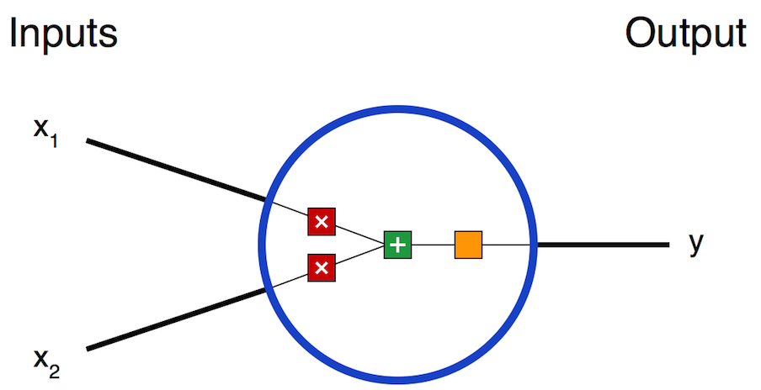
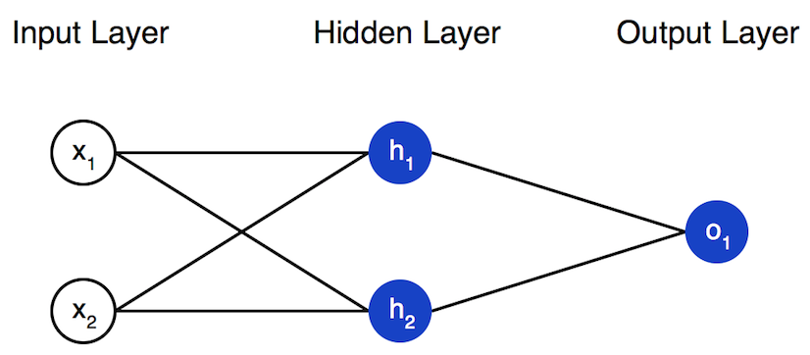
Background:
Logistic regression is the baseline supervised machine learning algorithm for classification
Neural network can be viewed as a series of logistic regression classifiers stacked on top of each other.

Slide 5


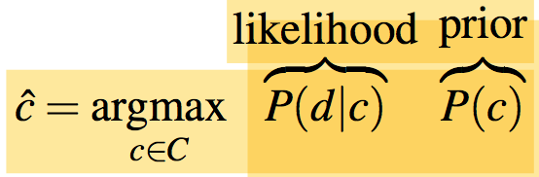
Generative and Discriminative Classifiers:
Naive Bayes is a generative classifier while Logistic regression is a discriminative classifier.
In a generative model: Given a test image (document), the system then asks whether it’s the cat model (class-1) or the dog model (class-2) that better fits the image, and chooses that as its label.
Recall that the naive Bayes assigns a class c to a document d not by directly computing P(c|d) but by computing a likelihood and a prior.

Slide 6
Generative and Discriminative Classifiers:
In a discriminative model: If all the dogs in the training data are wearing collars (feature-1) and the cats aren’t and If that one feature neatly separates the classes, the model is satisfied.
If you ask such a model what it knows about cats all it can say is that they don’t wear collars.

Slide 7
Components of a probabilistic ML classifier
A feature representation of the input. For each input observation x^{(i)}, this will be a vector of features [x₁,x₂,...,x_{n}]. We will generally refer to feature i for input x^{(j)} as x_{i}^{(j)}, sometimes simplified as x_{i}, but we will also see the notation f_{i}, f_{i}(x), or, for multiclass classification, f_{i}(c, x).
A classification function that computes yˆ (the estimated class), via p(y|x). We will study the sigmoid and softmax here.
An Objective function for learning, usually involving minimizing error on training examples. We will study the cross-entropy loss function.
An algorithm for optimizing the objective function. We will study the stochastic gradient descent algorithm.

Slide 8
A Memory Flash
Logistic regression has two phases:
Training: we train the system (specifically the weights w and bias b) using stochastic gradient descent and the cross-entropy loss.
Test: Given a test example x we compute p(y|x) and return the higher probability label y = 1 or y = 0.

Slide 9
Classification: the sigmoid
Consider a single input observation x, and its vector of features as [x₁,x₂,...,x_{n}]. The classifier output y can be 1 (meaning the observation x is a member of the class) or 0 (the observation x is not a member of the class). The features can represent counts of words in a document.
Logistic regression solves this task by learning, from a training set, a vector of weights and a bias term. Each weight w_{i} is a real number, and is associated with one of the input features x_{i}. The bias term, also called the intercept, is another real number that’s added to the weighted inputs.

Slide 10
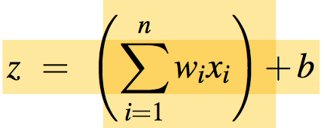
Classification: the sigmoid
To make a decision on a test instance— after we’ve learned the weights in training— the classifier first multiplies each x_{i} by its weight w_{i}, sums up the weighted features, and adds the bias term b. The resulting single number z expresses the weighted sum of the evidence for the class.

Slide 11

Classification: the sigmoid
These sums can be represented by using the dot product notation from linear algebra e.g. dot product of two vectors a and b, written as a · b is the sum of the products of the corresponding elements of each vector. So, previous equation becomes:
But note that nothing in Eq. forces z to be a legal probability, that is, to lie between 0 and 1. In fact, since weights are real-valued, the output might even be negative; z ranges from -∞ to ∞.

Slide 12
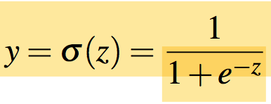
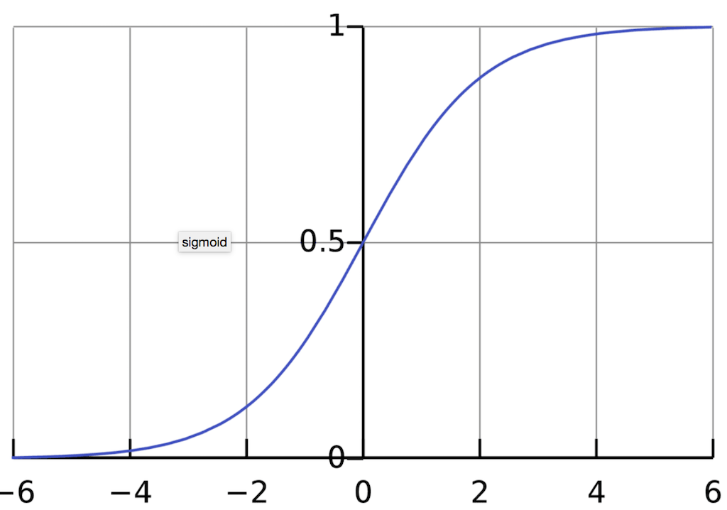
Classification: the sigmoid
To create a probability, we’ll pass z through the sigmoid function, σ(z). The sigmoid function (named because it looks like an s) is also called the logistic function, and gives logistic regression its name.
The sigmoid has the following equation.
The sigmoid takes a real-valued number and maps it into the range [0,1], which is just what we want for a probability.

Slide 13
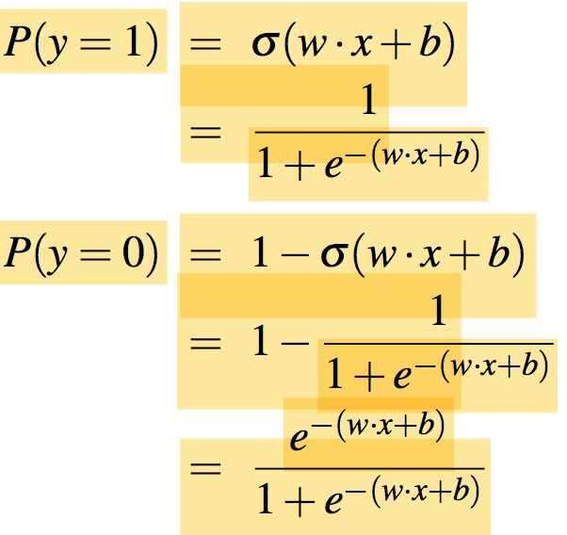
Classification: the sigmoid
If we apply the sigmoid to the sum of the weighted features, we get a number between 0 and 1. To make it a probability, we just need to make sure that the two cases, p(y = 1) and p(y = 0), sum to 1. We can do this as follows:

Slide 14
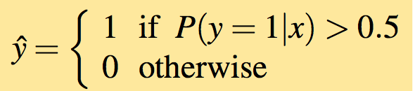
Classification: the sigmoid
Now we have an algorithm that given an instance x computes the probability P(y = 1|x).
How do we make a decision? For a test instance x, we say yes if the probability P(y = 1|x) is more than 0.5, and no otherwise.

Slide 15
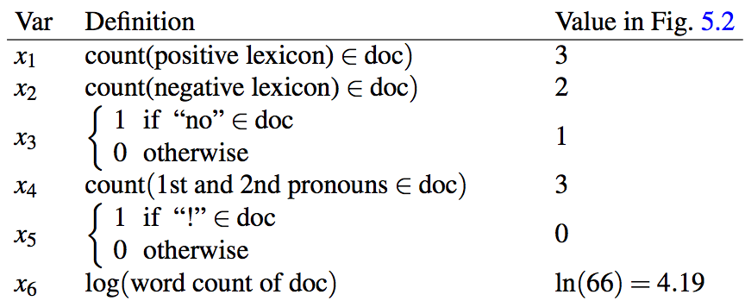
Example: sentiment classification
Suppose we are doing binary sentiment classification on movie review text, and whether to assign the sentiment class + or - to a review document doc.
We’ll represent each input observation by the following 6 features x₁...x₆ of the input. Fig. 5.2 shows the features in a sample mini test document.

Slide 16
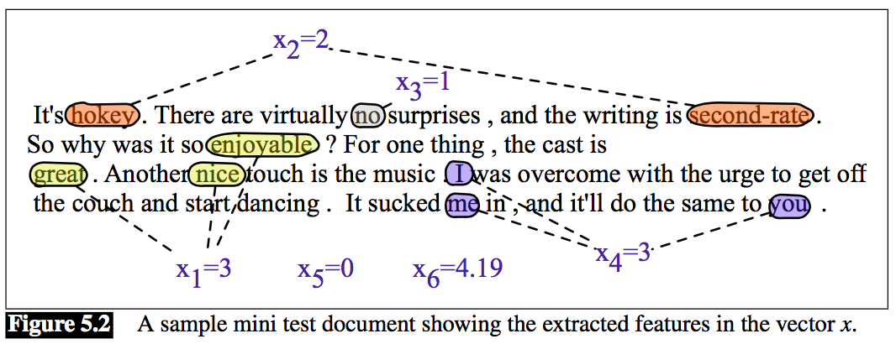
Example: sentiment classification
Let’s assume for the moment that we’ve already learned a real-valued weight for each of these features, and that the 6 weights corresponding to the 6 features are [2.5,-5.0,-1.2,0.5,2.0,0.7], while b = 0.1. (We’ll discuss in the next section how the weights are learned.)

Slide 17
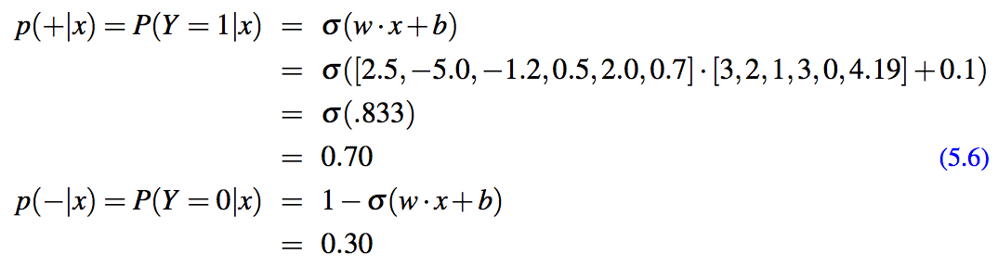
Example: sentiment classification
Given these 6 features and the input review x, P(+|x) and P(-|x) can be computed using Eq. on slide 11 as follows.

Slide 18
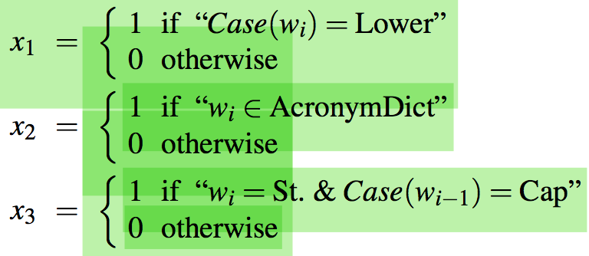
Example: sentiment classification
Logistic regression is commonly applied to all sorts of NLP tasks, and any property of the input can be a feature.
Period disambiguation: deciding if a period is the end of a sentence (EOS) or not-EOS. For example a period following a upper cased word is a likely to be an EOS, but if the word itself is St. and the previous word is capitalized, then the period is likely part of a shortening of the word street.

Slide 19
Example: sentiment classification
Features are generally designed with linguistic intuitions and the linguistic literature on the domain.
For logistic regression and naive Bayes these combination of features have to be designed by hand.
For large numbers of features, automatic methods can be used.
Logistic regression generally works better than naïve Bayes on larger documents or datasets and is a common default.

Slide 20
Learning in Logistic Regression
How are the parameters of the model, the weights w and bias b, learned?
This requires 2 components :
The first is the distance between the system output y^ and the gold output y, and we call this distance the loss function or the cost function. This cross-entropy loss is commonly used for logistic regression and for neural networks.
The second thing is an optimization algorithm (gradient descent or stochastic gradient descent algorithm) for iteratively updating the weights so as to minimize this loss function.
Now, we will discuss both of these one by one.

Slide 21
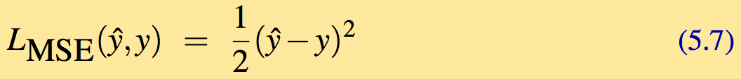
The cross-entropy loss function
We need a loss function that expresses, for an observation x, how close the classifier output yˆ = σ (w · x + b) is to the correct output y, which is 0 or 1.
Using a simple loss function that takes the mean squared error between yˆ and y.
MSE loss, which is very useful for some algorithms like linear regression, becomes harder to optimize, when it is applied to probabilistic classification.
(See at https://www.analyticsvidhya.com/blog/2019/08/detailed-guide-7-loss-functions-machine-learning-python-code/ )

Slide 22
The cross-entropy loss function
Instead, we use a loss function that prefers the correct class labels of the training example to be more likely. This is called conditional maximum likelihood estimation:
we choose the parameters w, b that maximize the log probability of the true y labels in the training data given the observations x. The resulting loss function is the negative log likelihood loss (since the log of values between 0.0 and 1.0 are negative), generally called the cross entropy loss.
Let’s derive this loss function, applied to a single observation x.
We’d like to learn weights that maximize the probability of the correct label p(y|x). Since there are only two discrete outcomes (1 or 0), this is a Bernoulli distribution, which can be expressed by probability density function on next slide (keeping in mind that if y=1, Eq. 5.8 simplifies to yˆ; if y=0, Eq. 5.8 simplifies to 1-yˆ):

Slide 23
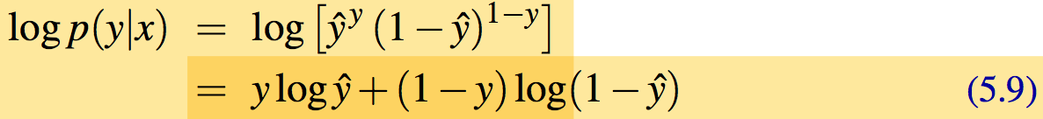
The cross-entropy loss function
Now we take the log of both sides for numeric stability, etc.
Eq. 5.9 describes a maximum log likelihood (loss function). In order to minimize this loss function, we’ll just flip the sign on Eq. 5.9. The result is the cross-entropy loss L_{CE} :

Slide 24
The cross-entropy loss function
Now, plug in the definition of yˆ = σ(w·x)+b:

Slide 25
The cross-entropy loss function
The negative log of this probability is a convenient loss metric since it goes from 0 (negative log of 1, ‘0’ no loss) to infinity (negative log of 0, infinite loss).
This loss function also insures that as probability of the correct answer is maximized, the probability of the incorrect answer is minimized; since the two sum to one, any increase in the probability of the correct answer is coming at the expense of the incorrect answer.

Slide 26
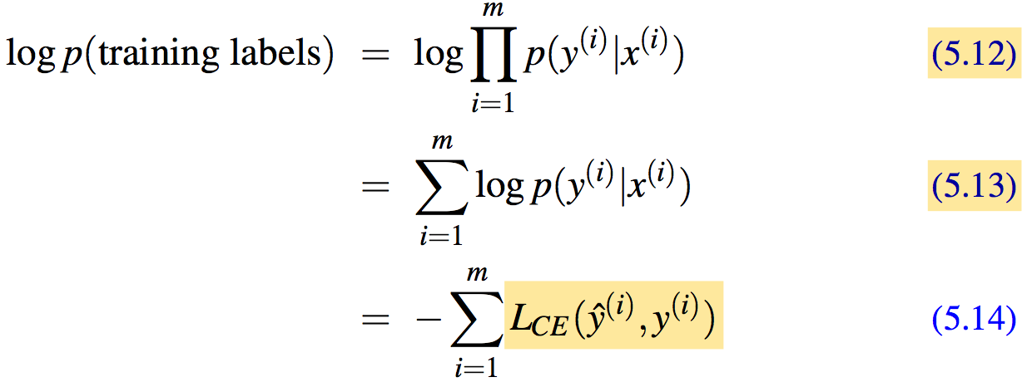
The cross-entropy loss function
Let’s now extend Eq. 5.10 from one example to the whole training set: assuming x^{(i)} and y^{(i)} mean the i^{th} training features and training label, respectively. We make the assumption that the training examples are independent:
Since log mn = log m + log n

Slide 27
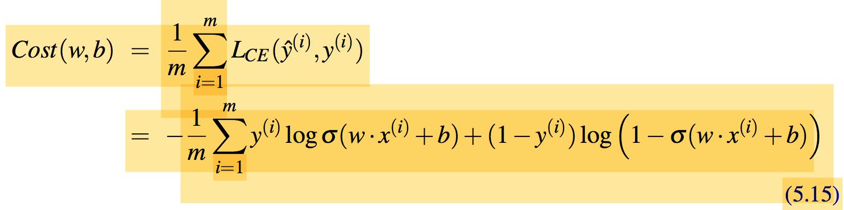
The cross-entropy loss function
Cost function for the whole dataset as the average loss for each example:
In the next section, we’ll see how to find the minimum.

Slide 28
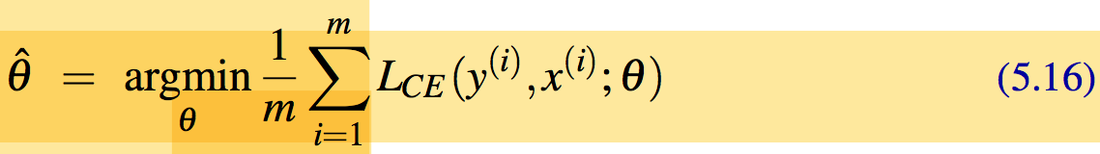
Gradient Descent: Our Goal
Our goal with gradient descent is to find the optimal weights: minimize the loss function. In the case of logistic regression, We'll use 𝜽 to refer to parameters w, b
Gradient descent is a method that finds a minimum of a function by figuring out in which direction (in the space of the parameters θ) the function’s slope is rising the most steeply, and moving in the opposite direction.

Slide 29
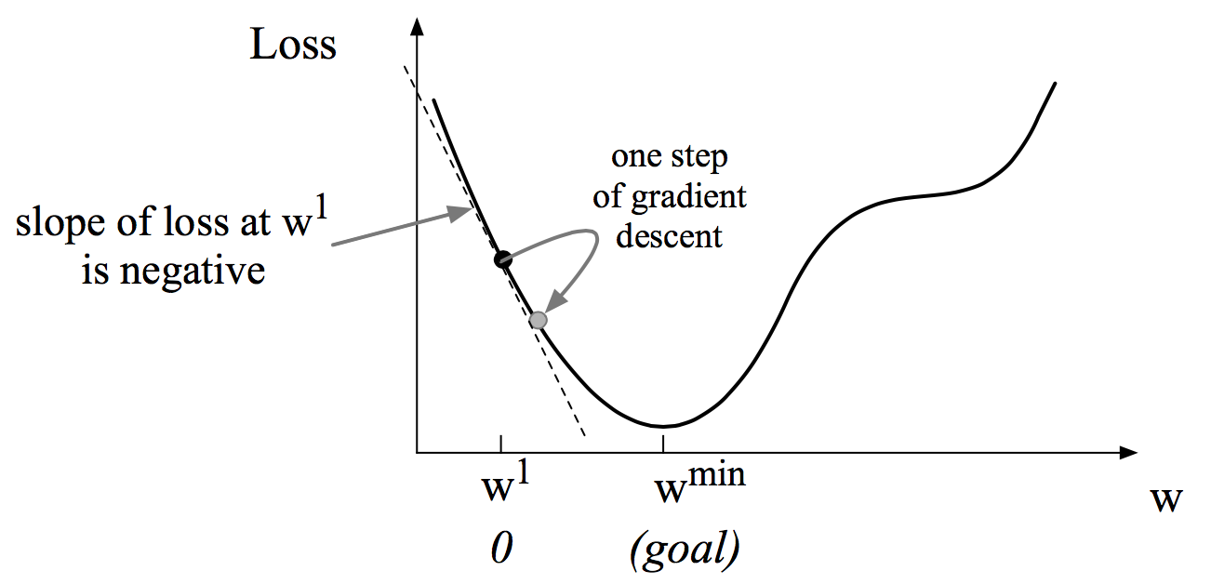
Gradient Descent: For One Scalar Variable
For logistic regression, this loss function is conveniently convex. A convex function has just one minimum; there are no local minima to get stuck in, so gradient descent starting from any point is guaranteed to find the minimum.
Gradient descent for one scalar variable w:

Slide 30
Gradient Descent: For One Scalar Variable
Given a random initialization of w at some value w₁, we need the algorithm to tell us whether at the next iteration, we should move left (making w₂ smaller than w₁) or right (making w₂ bigger than w₁) to reach the minimum.
We can see that the slope of this dotted line is negative. Thus to find the minimum, gradient descent tells us to move in a positive direction of w values.

Slide 31
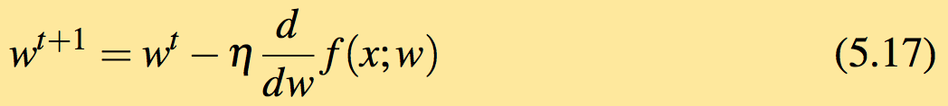
Gradient Descent: How Much To Move
How much to move is to calculate through the slope (gradient) value weighted by a learning rate η .

Slide 32
Gradient Descent: For N Dimensional Space
For N dimensional space: now let’s extend the intuition from a function of one scalar variable w to many variables.
We need a weight w_{i} for each x_{i} and for each variable w_{i} in w (plus the bias b), we have a slope
For multi variables w_{i}, we express the slope as a partial derivative ∂/∂w_{i}. The gradient ∇ is then defined as a vector of these partials. We’ll represent yˆ as f (x; θ ) to make the dependence on θ more obvious:
See details on partial derivatives if needed

Slide 33
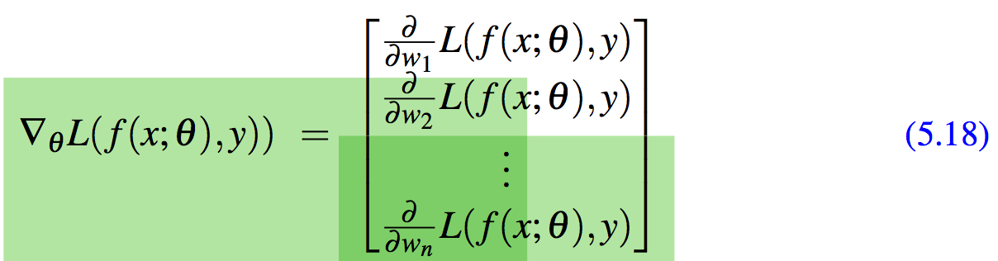
Gradient Descent: Updating θ
Final equation after updating θ based on the gradient ∇

Slide 34
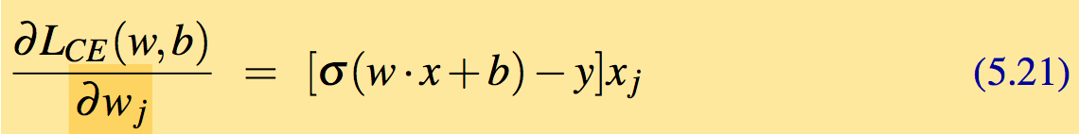
Gradient Descent: Derivation
Derivative of gradient for one observation vector x (For proof see Section 5.8):
Weight w_{j} represents the difference between our predicted values yˆ = σ (w · x + b) and the true y, multiplied by input value x_{j} .

Slide 35
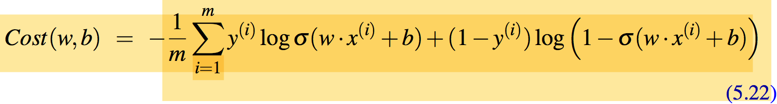
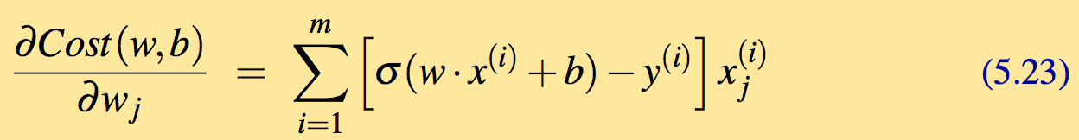
Gradient Descent: For Entire Data Set
Loss for an entire dataset is just the average loss using equation 5.15:
Gradient for multiple data points is the sum of the individual gradients:

Slide 36
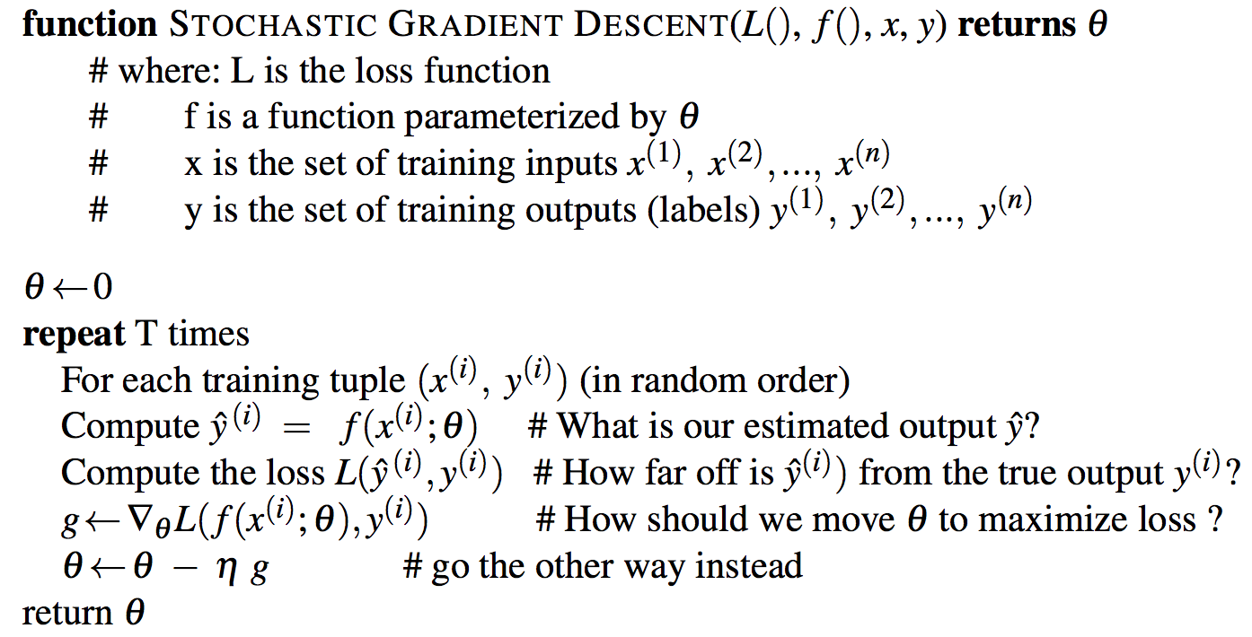
Stochastic Gradient Descent Algorithm

Slide 37
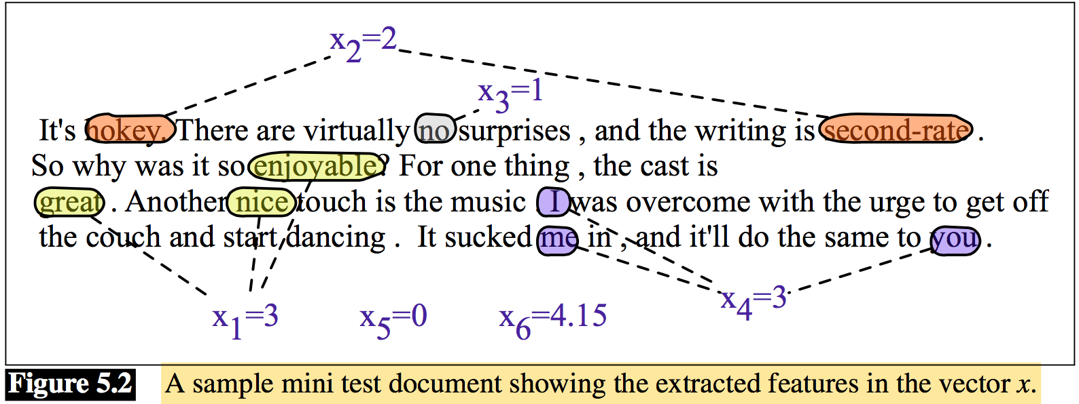
Working through an example
Let’s walk though a single step of the gradient descent algorithm for a single observation x, whose sentiment value is y = 1 or 0, and with only two features:
x1 = 3 (count of positive lexicon words)
x2 = 2 (count of negative lexicon words)
Assume the initial weights and bias in θ⁰ are all set to 0, and the initial learning rate η is 0.1:
w1=w2=b = 0 and η = 0.1

Slide 38
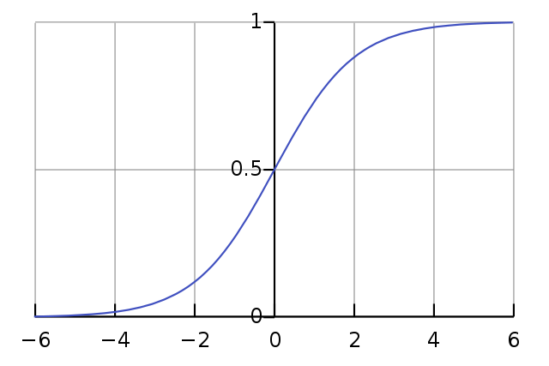
An example…
wikipedia
So after one step of gradient descent, the weights θ¹ have shifted to θ² as: w1 = .15, w2 =.1,and b=.05

Slide 39
Overfitting/Regularization
Useful or harmless features
+
X1 = "this"
X2 = "movie
X3 = "hated"
This movie drew me in, and it'll do the same to you.
X4 = "drew me in"
-
4gram features that just "memorize" training set and might cause problems
I can't tell you how much I hated this movie. It sucked.
X5 = "the same to you"
X7 = "tell you how much"
Adapted from Jurafsky’s slides

Slide 40
Overfitting/Regularization
4-gram or 5-gram model on tiny data will just memorize the data
100% accuracy on the training set
It will be surprised by all the novel 4-grams in the test data
Low accuracy on test set
Models that are too powerful can overfit the data
Fitting the details of the training data so exactly that the model doesn't generalize well to the test set
There are various ways to avoid overfitting
Regularization in logistic regression (see chapter 5)
Dropout in neural networks
Adapted from Jurafsky’s slides

Slide 41
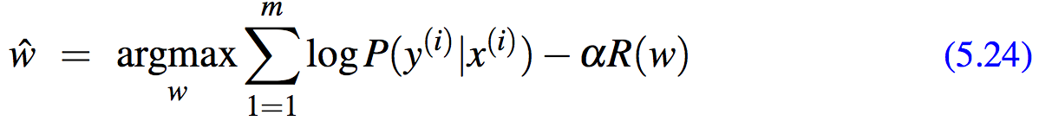
Overfitting/Regularization
To avoid overfitting (reduce weights with high values), a regularization term is added to the objective function in Eq. 5.16, resulting in the following objective:
The new component, R(w) is called a regularization term, and is used to penalize large weights.

Slide 42
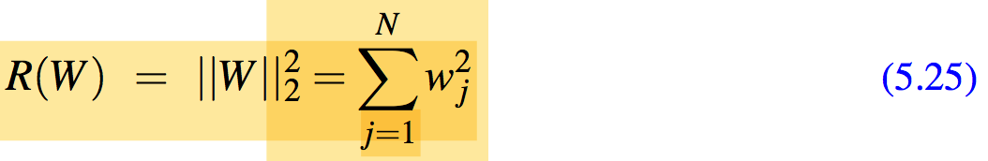
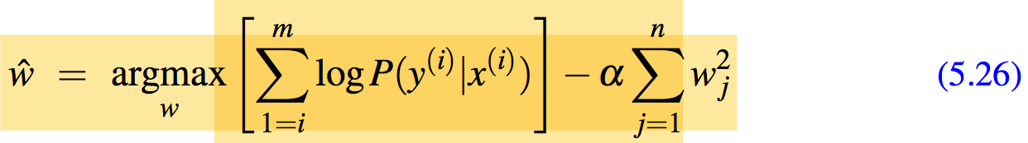
Overfitting/Regularization
Two common regularization terms R(w): L2 and L1.
L2 regularization: quadratic function of the weight values, as it uses the square of the L2 norm of the weight values. The L2 norm, ||W||₂, is the same as the Euclidean distance:
The L2 regularized objective function becomes:

Slide 43
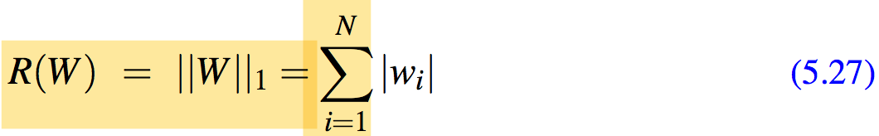
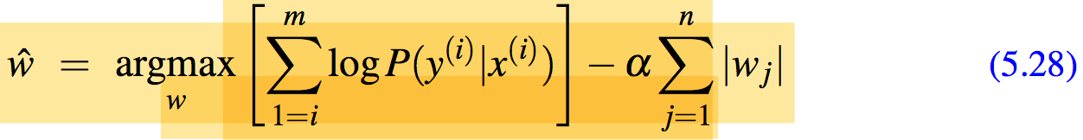
Overfitting/Regularization
L1 regularization: linear function of the weight values, named after the L1 norm ||W||₁, the sum of the absolute values of the weights, or Manhattan distance :
The L1 regularized objective function becomes:

Slide 44
Overfitting/Regularization
L2 regularization is easier to optimize because of its simple derivative (the derivative of w² is just 2w), while L1 regularization is more complex (the derivative of |w| is non- continuous at zero).
L2 prefers weight vectors with many small weights, L1 prefers sparse solutions with some larger weights.
α values can be computed manually or automatic through the source code as is on this link.

Slide 45
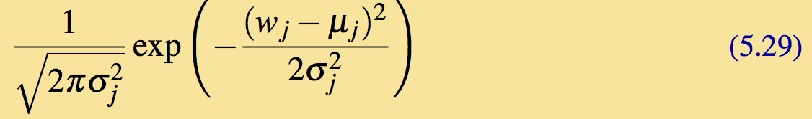
Overfitting/Regularization
L1 regularization can be viewed as a Laplace prior on the weights while weights in L2 regularization are Gaussian distribution with mean μ = 0.
A Gaussian for a weight w_{j} is
If we multiply each weight by a Gaussian prior on the weight, we are thus maximizing the following constraint:

Slide 46
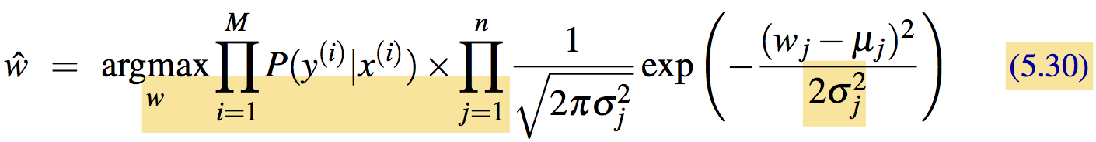
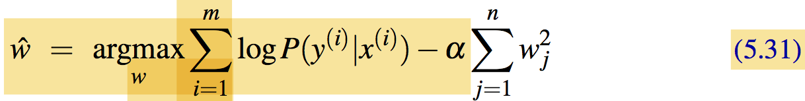
Overfitting/Regularization
which in log space, with μ = 0, and assuming 2σ² = 1, corresponds to
which is in the same form as Eq. 5.26.

Slide 47
Homework # 1 (a)
Visit the link on the previous slide, download the source code and learn the method to calculate the value of Alpha/Lambda.
Submit in hard form on the beginning of next lecture.

Slide 48
Multinomial logistic regression
For more than two classes, we use multinominal logistic regression, also called softmax regression (or, historically, the maxent classifier). In multinominal logistic regression, we want to know the probability of target y being in each potential class c=C, p(y = c|x).
The softmax function takes a vector z = [z₁,z₂,...,z_{k}] of k arbitrary values and maps them to a probability distribution, with each value in the range (0,1), and all the values summing to 1.

Slide 49
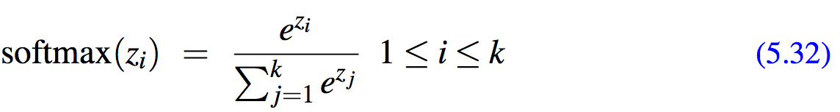
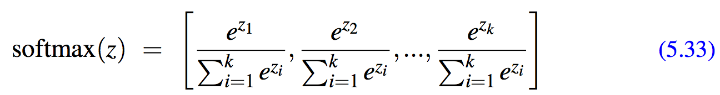
Multinomial logistic regression
For a vector z of dimensionality k, the softmax is defined as:
The softmax of an input vector z = [z₁,z₂,...,z_{k}] is thus a vector itself:
For example given a vector: z = [0.6, 1.1, 1.5, 1.2, 3.2, 1.1] the result softmax(z) is [0.055, 0.090, 0.0067, 0.10, 0.74, 0.010]

Slide 50
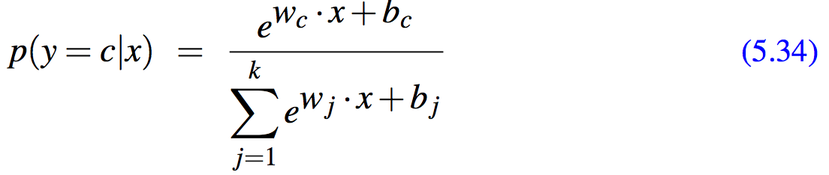
Multinomial logistic regression
Like the sigmoid, for softmax, we’ll need separate weight vectors (and bias) for each of the K classes.

Slide 51
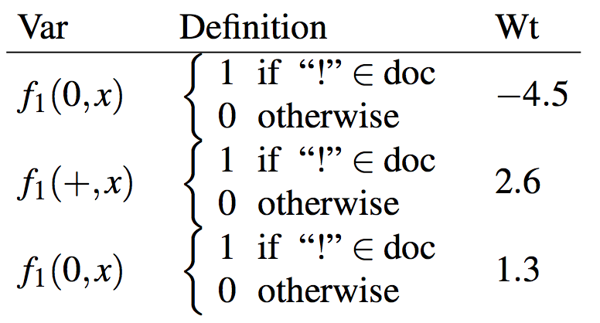
Features in Multinomial Logistic Regression
fi(c,x), meaning feature i for a particular class c for a given observation x.
Feature related to exclamation marks might have a negative weight for 0 documents, and a positive weight for + or - documents:
f₁(-,x)

Slide 52
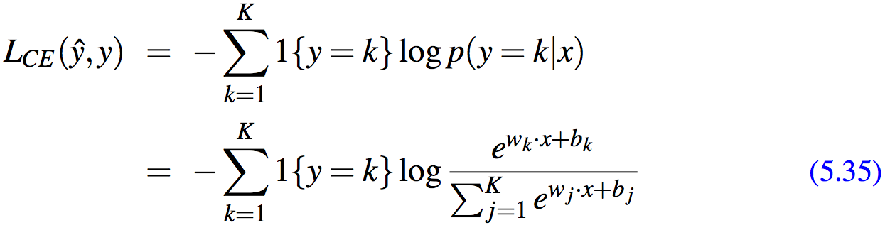
Learning in Multinomial Logistic Regression
Slightly different loss function because it uses the softmax rather than sigmoid classifier, The loss function for a single example x is the sum of the logs of the K output classes:
Function 1{} evaluates to 1 if the condition in the brackets is true and to 0 otherwise.

Slide 53
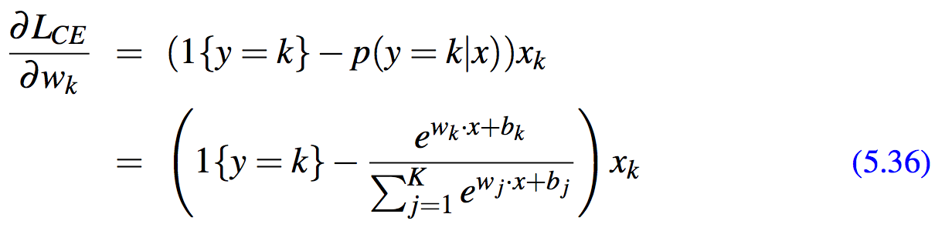
Learning in Multinomial Logistic Regression
The gradient for a single example turns out to be very similar to the gradient for logistic regression.
It is the difference between the value for the true class k (which is 1) and the probability the classifier outputs for class k, weighted by the value of the input x_{k}:

Slide 54
Homework # 1(b)
Visit the following links for
(a) binary/multinomial logistic regression:
(b) Multinomial logistic regression:
Understand the source code and configurations.
Implement the logistics regression and multinomial logistics regression
Submit the homework and be ready for a presentation on some day.

Slide 55
Sources to be read
Ratnaparkhi, A. (1996). A maximum entropy part-of- speech tagger. In EMNLP 1996, Philadelphia, PA, pp. 133– 142.
Ratnaparkhi, A. (1997). A linear observed time statisti- cal parser based on maximum entropy models. In EMNLP 1997, Providence, RI, pp. 1–10.
Nigam, K., Lafferty, J. D., and McCallum, A. (1999). Using maximum entropy for text classification. In IJCAI-99 work- shop on machine learning for information filtering, pp. 61– 67.

Slide 56
Lexicons as Features for Logistic Regression
Slides 56 to 82, adapted from the lecture slides of Daniel Jurafsky
Additional Readings
Reminder: Sentiment Lexicons

Slide 57
The General Inquirer
Philip J. Stone, Dexter C Dunphy, Marshall S. Smith, Daniel M. Ogilvie. 1966. The General Inquirer: A Computer Approach to Content Analysis. MIT Press
Home page: http://www.wjh.harvard.edu/~inquirer
List of Categories: http://www.wjh.harvard.edu/~inquirer/homecat.htm
Spreadsheet: http://www.wjh.harvard.edu/~inquirer/inquirerbasic.xls
Categories:
Positiv (1915 words) and Negativ (2291 words)
Strong vs Weak, Active vs Passive, Overstated versus Understated
Pleasure, Pain, Virtue, Vice, Motivation, Cognitive Orientation, etc
Free for Research Use

Slide 58
LIWC (Linguistic Inquiry and Word Count)
Pennebaker, J.W., Booth, R.J., & Francis, M.E. (2007). Linguistic Inquiry and Word Count: LIWC 2007. Austin, TX
http://www.liwc.net/ 2300 words, >70 classes
Affective Processes
negative emotion (bad, weird, hate, problem, tough)
positive emotion (love, nice, sweet)
Cognitive Processes
Tentative (maybe, perhaps, guess),
Inhibition (block, constraint)
Pronouns (I/me/you),
Negation (no, never), Quantifiers (few, many)

Slide 59
MPQA Subjectivity Cues Lexicon
Theresa Wilson, Janyce Wiebe, and Paul Hoffmann (2005). Recognizing Contextual Polarity in
Phrase-Level Sentiment Analysis. Proc. of HLT-EMNLP-2005.
Riloff and Wiebe (2003). Learning extraction patterns for subjective expressions. EMNLP-2003.
Home page: http://mpqa.cs.pitt.edu/lexicons/
6885 words from 8221 lemmas
2718 positive
4912 negative
Each word annotated for intensity (strong, weak)
GNU GPL

Slide 60
type=weaksubj len=1 word1=abandoned pos1=adj stemmed1=n priorpolarity=negative
type=weaksubj len=1 word1=abandonment pos1=noun stemmed1=n priorpolarity=negative
type=weaksubj len=1 word1=abandon pos1=verb stemmed1=y priorpolarity=negative
type=strongsubj len=1 word1=abase pos1=verb stemmed1=y priorpolarity=negative
type=strongsubj len=1 word1=abasement pos1=anypos stemmed1=y priorpolarity=negative
type=strongsubj len=1 word1=abash pos1=verb stemmed1=y priorpolarity=negative
type=weaksubj len=1 word1=abate pos1=verb stemmed1=y priorpolarity=negative

Slide 61
Bing Liu Opinion Lexicon
Minqing Hu and Bing Liu. Mining and Summarizing Customer Reviews. ACM SIGKDD-2004.
Bing Liu's Page on Opinion Mining
http://www.cs.uic.edu/~liub/FBS/opinion-lexicon-English.rar
6786 words
2006 positive
4783 negative

Slide 62
Lexicons as Features for Logistic Regression
Emotion Lexicons

Slide 63
Scherer’s typology of affective states
Emotion: relatively brief episode of synchronized response of all or most organismic subsystems in response to the evaluation of an event as being of major significance
angry, sad, joyful, fearful, ashamed, proud, desperate
Mood: diffuse affect state …change in subjective feeling, of low intensity but relatively long duration, often without apparent cause
cheerful, gloomy, irritable, listless, depressed, buoyant
Interpersonal stance: affective stance taken toward another person in a specific interaction, coloring the interpersonal exchange
distant, cold, warm, supportive, contemptuous
Attitudes: relatively enduring, affectively colored beliefs, preferences predispositions towards objects or persons
liking, loving, hating, valuing, desiring
Personality traits: emotionally laden, stable personality dispositions and behavior tendencies, typical for a person
nervous, anxious, reckless, morose, hostile, envious, jealous

Slide 64
Two families of theories of emotion
Atomic basic emotions
A finite list of 6 or 8, from which others are generated
Dimensions of emotion
Valence (positive negative)
Arousal (strong, weak)
Control

Slide 65
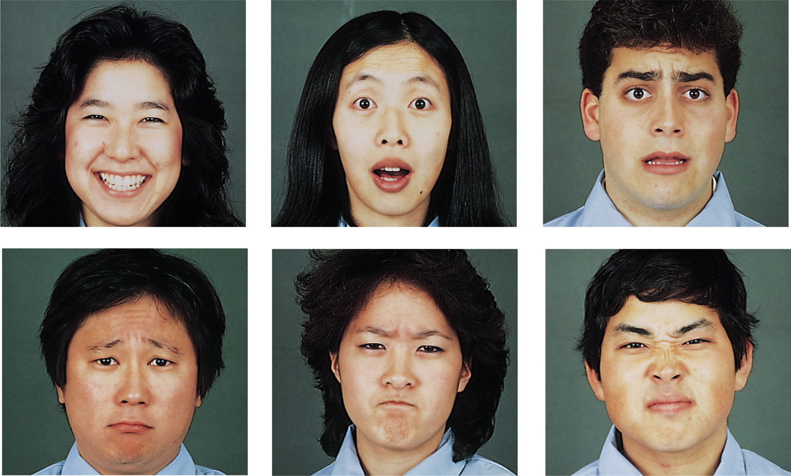
Ekman’s 6 basic emotions:
Surprise, happiness, anger, fear, disgust, sadness
Ekman &
Matsumoto
1989

Slide 66
Valence/Arousal Dimensions
High arousal, low pleasure High arousal, high pleasure
anger excitement
Low arousal, low pleasure Low arousal, high pleasure
sadness relaxation
arousal
valence

Slide 67
Atomic units vs. Dimensions
Distinctive
Emotions are units.
Limited number of basic emotions.
Basic emotions are innate and universal
Dimensional
Emotions are dimensions.
Limited # of labels but unlimited number of emotions.
Emotions are culturally learned.
Adapted from Julia Braverman

Slide 68
One emotion lexicon from each paradigm!
8 basic emotions:
NRC Word-Emotion Association Lexicon (Mohammad and Turney 2011)
Dimensions of valence/arousal/dominance
Warriner, A. B., Kuperman, V., and Brysbaert, M. (2013)
Both built using Amazon Mechanical Turk

Slide 69
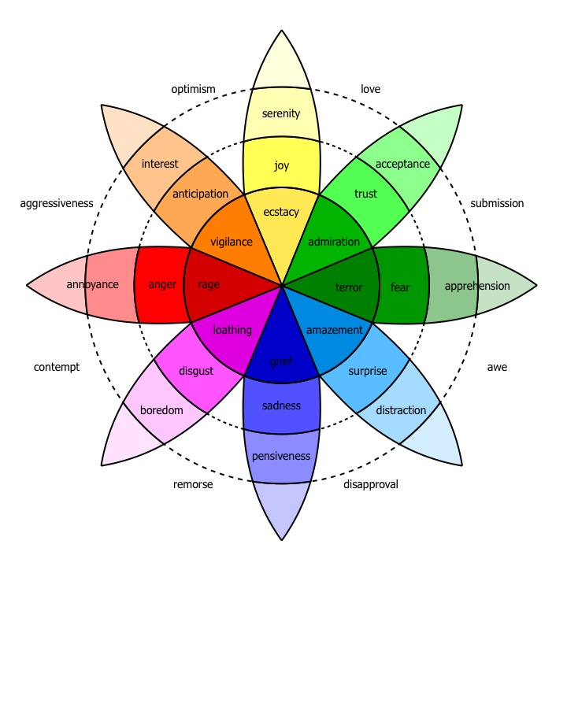
Plutchick’s wheel of emotion
8 basic emotions
in four opposing pairs:
joy–sadness
anger–fear
trust–disgust
anticipation–surprise
wikipedia

Slide 70
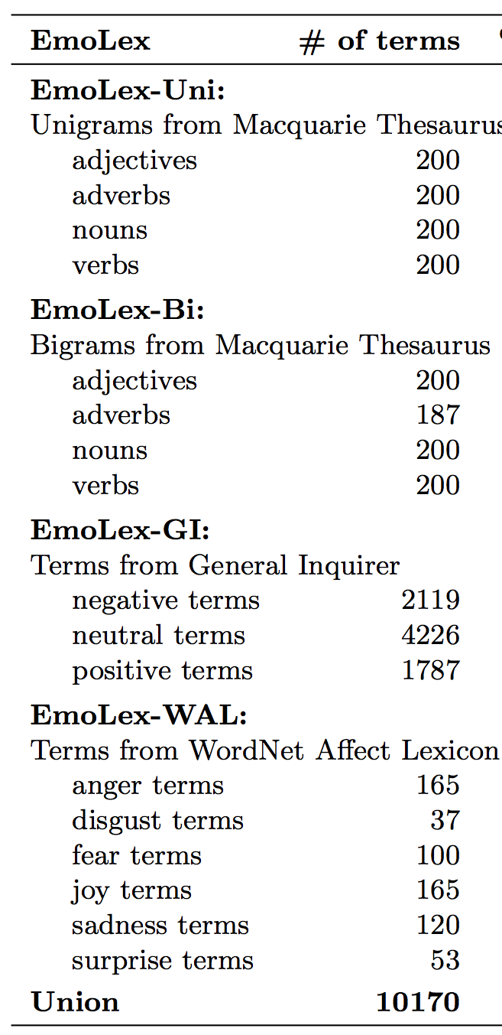
NRC Word-Emotion Association Lexicon
Mohammad and Turney 2011
10,000 words chosen mainly from earlier lexicons
Labeled by Amazon Mechanical Turk
5 Turkers per hit
Give Turkers an idea of the relevant sense of the word
Result:
amazingly anger 0
amazingly anticipation 0
amazingly disgust 0
amazingly fear 0
amazingly joy 1
amazingly sadness 0
amazingly surprise 1
amazingly trust 0
amazingly negative 0
amazingly positive 1

Slide 71
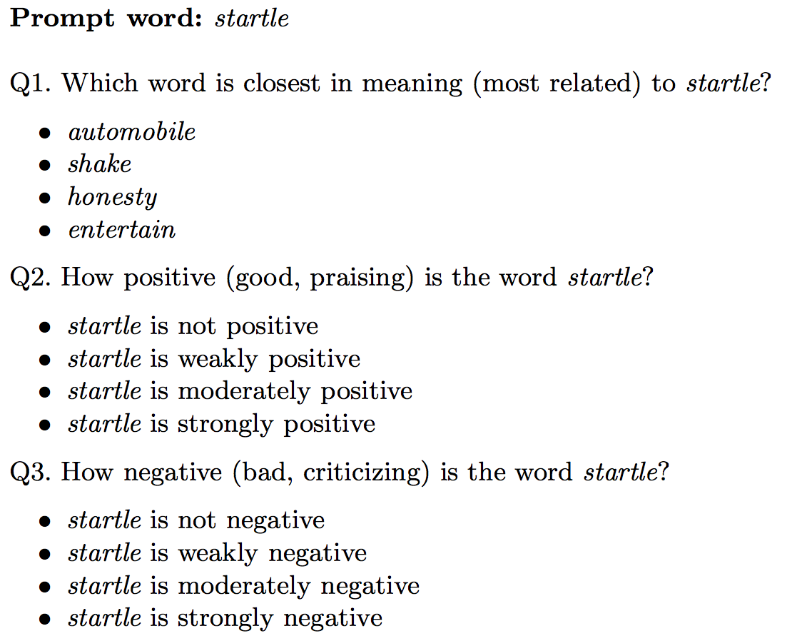
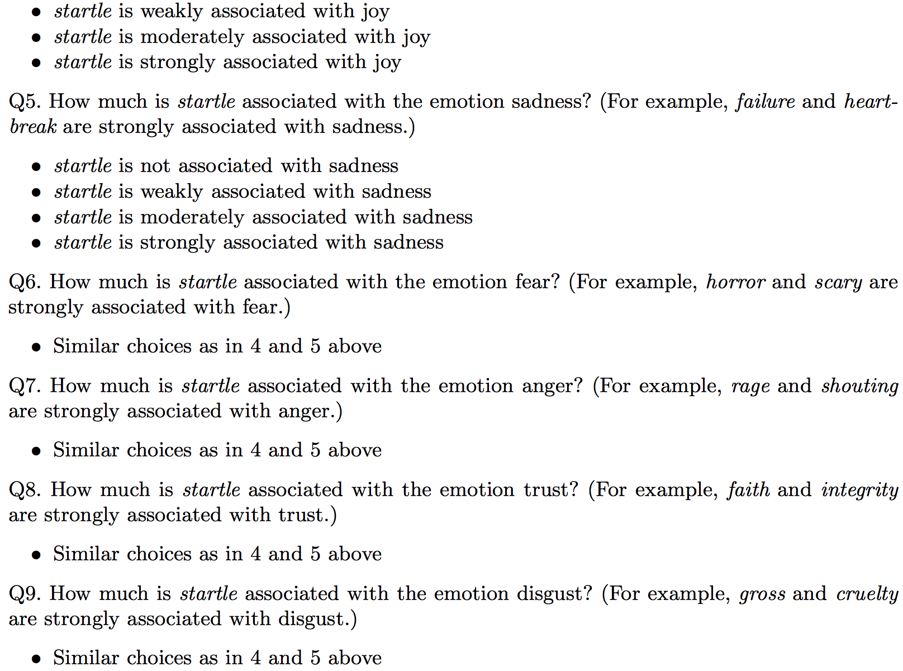
The AMT Hit
…

Slide 72
Lexicon of valence, arousal, and dominance
Warriner, A. B., Kuperman, V., and Brysbaert, M. (2013). Norms of valence, arousal, and dominance for 13,915 English lemmas. Behavior Research Methods 45, 1191-1207.
Supplementary data: This work is licensed under a Creative Commons Attribution-NonCommercial-NoDerivs 3.0 Unported License.
Ratings for 14,000 words for emotional dimensions:
valence (the pleasantness of the stimulus)
arousal (the intensity of emotion provoked by the stimulus)
dominance (the degree of control exerted by the stimulus)

Slide 73
Lexicon of valence, arousal, and dominance
valence (the pleasantness of the stimulus)
9: happy, pleased, satisfied, contented, hopeful
1: unhappy, annoyed, unsatisfied, melancholic, despaired, or bored
arousal (the intensity of emotion provoked by the stimulus)
9: stimulated, excited, frenzied, jittery, wide-awake, or aroused
1: relaxed, calm, sluggish, dull, sleepy, or unaroused;
dominance (the degree of control exerted by the stimulus)
9: in control, influential, important, dominant, autonomous, or controlling
1: controlled, influenced, cared-for, awed, submissive, or guided
Again produced by AMT

Slide 74
Lexicon of valence, arousal, and dominance: Examples
Valence |  | Arousal |  | Dominance
vacation | 8.53 | rampage | 7.56 | self | 7.74
happy | 8.47 | tornado | 7.45 | incredible | 7.74
whistle | 5.7 | zucchini | 4.18 | skillet | 5.33
conscious | 5.53 | dressy | 4.15 | concur | 5.29
torture | 1.4 | dull | 1.67 | earthquake | 2.14

Slide 75
Lexicons as features for logistic regression
Other Useful Lexicons

Slide 76
Concreteness versus abstractness
The degree to which the concept denoted by a word refers to a perceptible entity.
Do concrete and abstract words differ in connotation?
Storage and retrieval?
Bilingual processing?
Relevant for embodied view of cognition (Barsalou 1999 inter alia)
Do concrete words activate brain regions involved in relevant perception
Brysbaert, M., Warriner, A. B., and Kuperman, V. (2014) Concreteness ratings for 40 thousand generally known English word lemmas Behavior Research Methods 46, 904-911.
Supplementary data: This work is licensed under a Creative Commons Attribution-NonCommercial-NoDerivs 3.0 Unported License.
37,058 English words and 2,896 two-word expressions ( “zebra crossing” and “zoom in”),
Rating from 1 (abstract) to 5 (concrete)
Calibrator words:
shirt, infinity, gas, grasshopper, marriage, kick, polite, whistle, theory, and sugar

Slide 77
Concreteness versus abstractness
Brysbaert, M., Warriner, A. B., and Kuperman, V. (2014) Concreteness ratings for 40 thousand generally known English word lemmas Behavior Research Methods 46, 904-911.
Supplementary data: This work is licensed under a Creative Commons Attribution-NonCommercial-NoDerivs 3.0 Unported License.
Some example ratings from the final dataset of 40,000 words and phrases
banana 5
bathrobe 5
bagel 5
brisk 2.5
badass 2.5
basically 1.32
belief 1.19
although 1.07

Slide 78
Lexicons as features for logistic regression
Using the lexicons to detect affect

Slide 79
Lexicons for detecting document affect: Simplest unsupervised method
Sentiment:
Sum the weights of each positive word in the document
Sum the weights of each negative word in the document
Choose whichever value (positive or negative) has higher sum
Emotion:
Do the same for each emotion lexicon

Slide 80
Lexicons for detecting document affect: Simplest unsupervised method
Sentiment = + if f+ > f-

Slide 81
Lexicons for detecting document affect: Slightly more complex unsupervised method

Slide 82
Lexicons for detecting document affect: Simplest supervised method
Build a classifier
Predict sentiment (or emotion, or etc) given features
Use “counts of lexicon categories” as a features
LIWC category “cognition” had count of 7
NRC Emotion category “anticipation” had count of 2
Baseline
Use counts of all the words and bigrams in the training set
Like the naïve bayes algorithm
This is hard to beat
But only works if the training and test sets are very similar

