Slide 1
Chapter 9:
Sequence Processing with Recurrent Networks
(Review of Chap 7 & 8)

Slide 2
Language Models Vs Recurrent Neural Network
Sliding window approach is problematic for a number of reasons:
Anything outside the context window has no impact on the decision being made.
In context window, it is difficult for networks to learn systematic patterns arising from phenomena like constituency.
Recurrent neural networks (RNN), a class of networks designed to address these problems by processing sequences explicitly as sequences, allowing us to handle variable length inputs without the use of arbitrary fixed-sized windows.

Slide 3
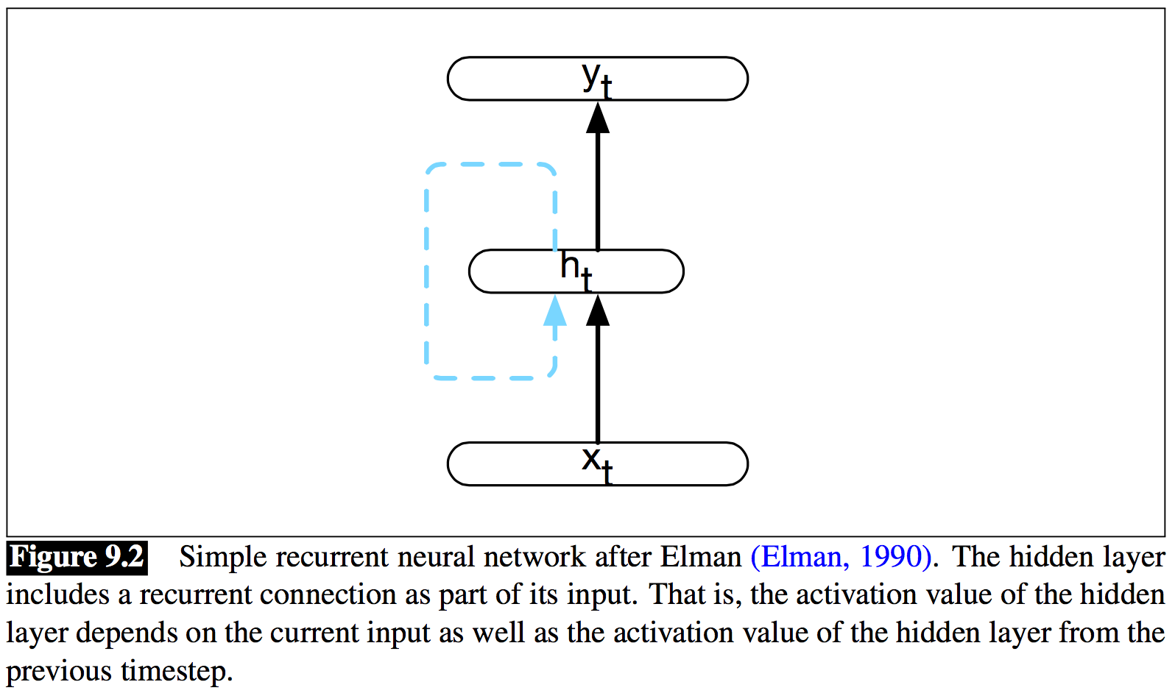
Simple Recurrent Networks (SRNs)
SRNs or Elman Networks: Any network where the value of a unit is directly, or indirectly, dependent on its own output as an input or has a cycle.
Fig. 9.2 abstracts the recurrent structure of an SRN.

Slide 4
Simple Recurrent Networks (SRNs)
Current input element, x_{t}, is multiplied by a weight matrix and then passed through an activation function to compute an activation value for a hidden layer of units which is used to calculate a corresponding output, y_{t}.
Difference from a feed- forward network lies in the recurrent link shown in the figure with the dashed line. This link augments the input to the hidden layer with the activation value of the hidden layer from the preceding point in time.
The hidden layer from the previous time step provides a form of memory, or context, that encodes earlier processing and informs the decisions to be made at later points in time.

Slide 5
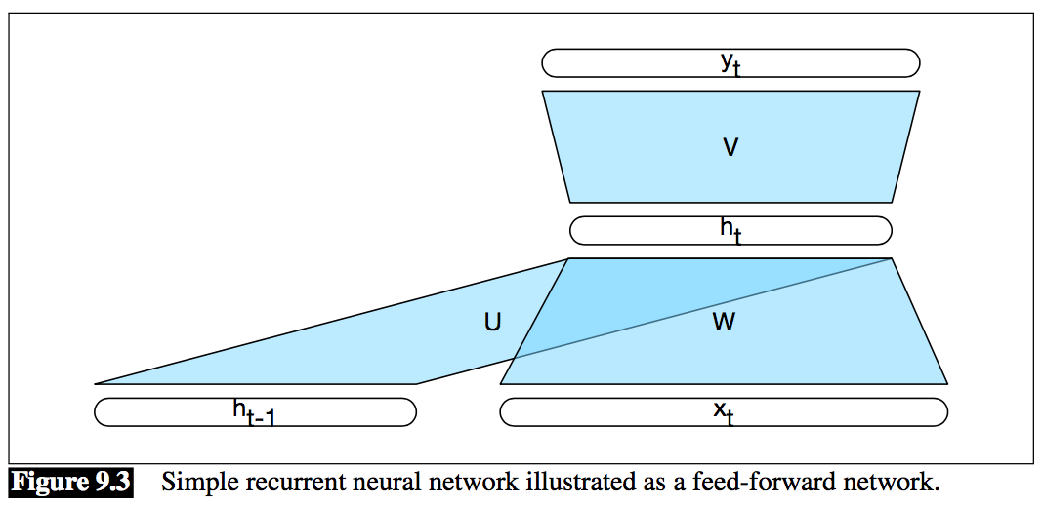
Simple Recurrent Networks (SRNs)
Adding this temporal dimension makes recurrent networks appear to be more exotic than non-recurrent architectures. But in reality, they’re not all that different.
we’re still performing the standard feed-forward calculation. To see this, consider Fig. 9.3
The most significant addition lies in the new set of weights, U, that connect the hidden layer from the previous time step to the current hidden layer.

Slide 6
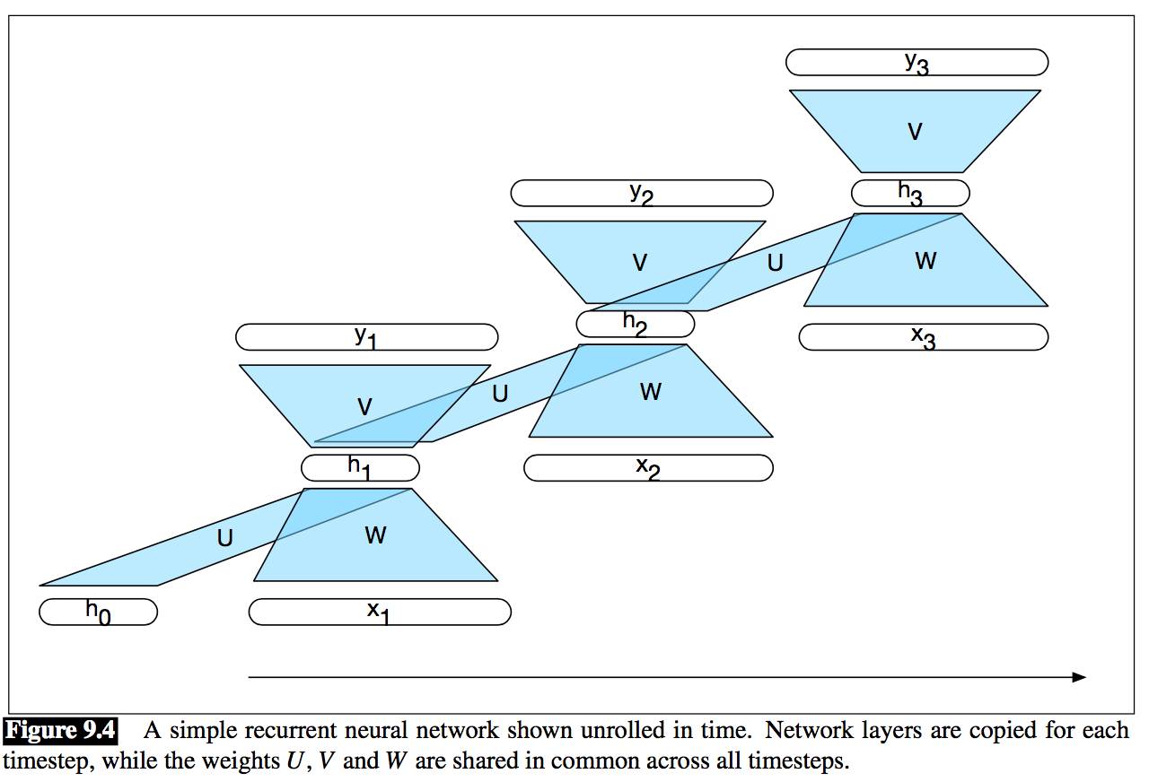
Inference in Simple RNNs
h_{t} = g(Uh_{t−1}+Wx_{i})
y_{t} = f(Vh_{t})
OR y_{t} = softmax(V h_{t} )

Slide 7
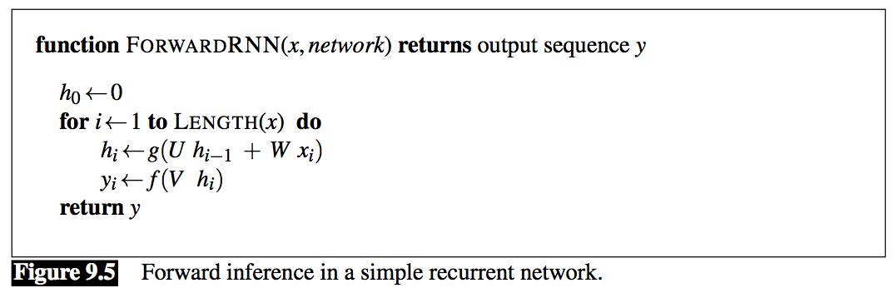
Inference in Simple RNNs

Slide 8
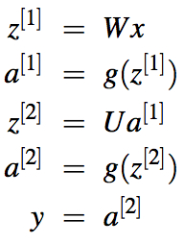
Training
Similar to Chap 7 notation for feed forward network:
Now according to Figure 9.4:
First, to compute the loss function for the output at time t we need the hidden layer from time t − 1.
Second, the hidden layer at time t influences both the output at time t and the hidden layer at time t + 1

Slide 9

Training
To compute the gradients, we need to update the weights U , V , and W here?
To review from Chapter 7, we need to compute the derivative of the loss function L with respect to the weights V .
The first term is just the derivative of the loss function with respect to the network output, which is just the activation of the output layer, a.
The second term is the derivative of the network output with respect to the intermediate network activation z, which is a function of the activation function g.
The final term is the derivative of the network activation with respect to the weights V , which is just the activation value of the current hidden layer h_{t}.

Slide 10
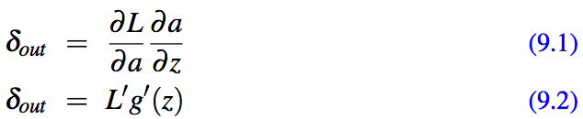

Training
First two terms to define δ , an error term that represents how much of the scalar loss is attributable to each of the units in the output layer.
Final gradient we need to update the weight matrix V is just:
Moving on, we need to compute the corresponding gradients for the weight matrices W and U: ∂L/∂W and ∂L/∂U .
The hidden state at time t contributes to the output and associated error at time t and to the output and error at the next timestep, t + 1. Therefore, the error term, δ_{h}, for the hidden layer must be the sum of the error term from the current output and its error from the next time step.
δ_{h} = g′(z)Vδ_{out} +δ_{next}

Slide 11
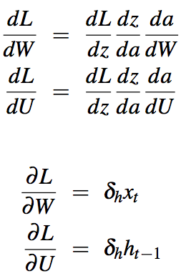
Training
Given this total error term for the hidden layer, we can compute the gradients for the weights U and W in the usual way using the chain rule as we did in Chapter 7.
This will update the matrices U and W through ordinary backpropagation.

Slide 12
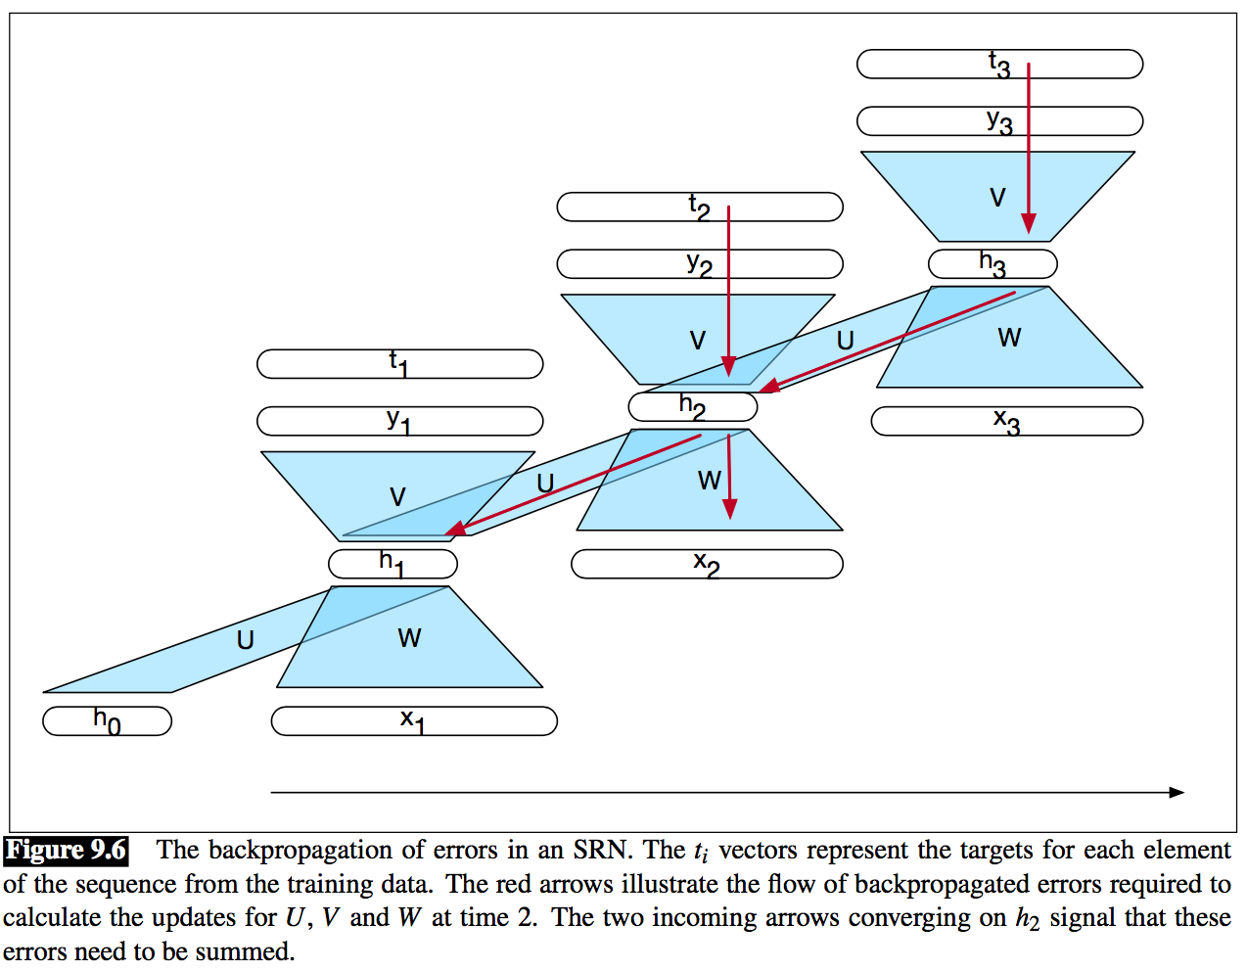
Training

Slide 13
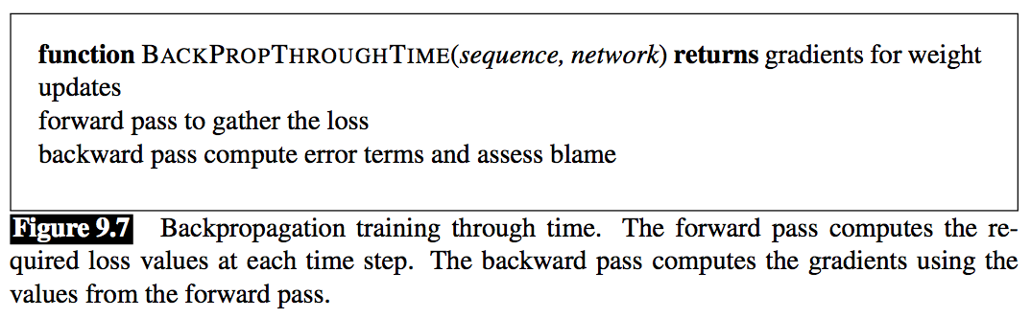
Training
Proportional blame back to the previous hidden layer h_{t−1}
In this simple case: no need to back- propagate the error through W to the input x, since the input training data is assumed to be fixed. If we wished to update our input word or character embeddings we would backpropagate the error through to them as well.

Slide 14
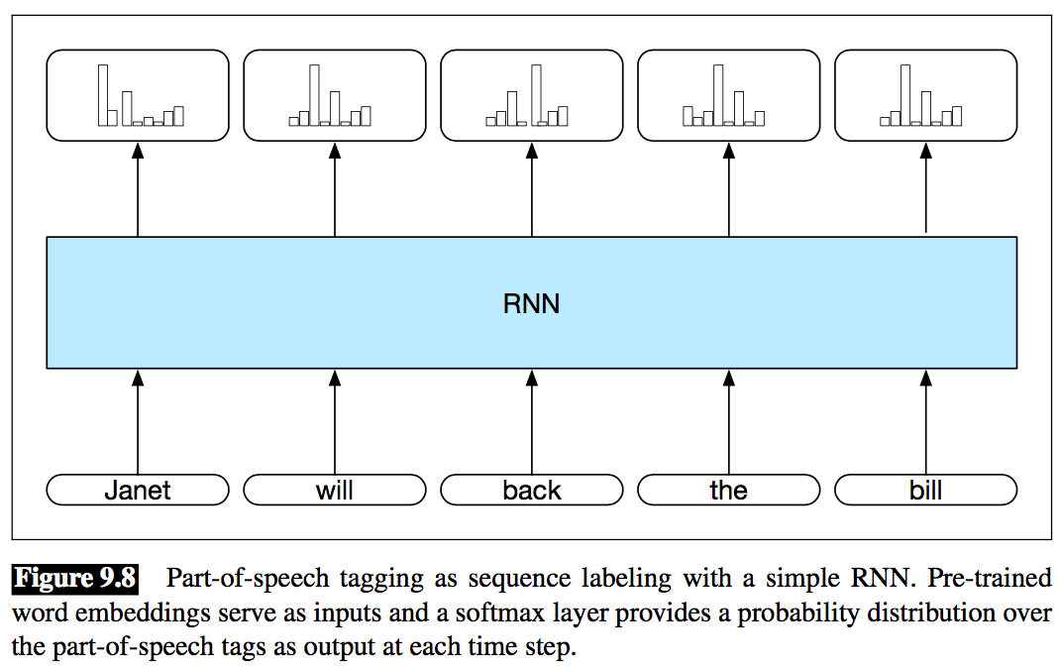
Unrolled Networks as Computational Graphs
With modern computational frame- works and computing resources, unrolling a recurrent network into a deep feed-forward computational graph is quite practical.
In such an approach, we provide a template that specifies the basic SRN, including input, output, and hidden layers, the weight matrices, as well as the activation and output functions to be used.

Slide 15

Applications of RNNs
SRN are useful to language modeling, sequence labeling, sequence classification i.e. sentiment analysis and topic classification, summarization and machine translation.
Sequence Labeling:
In sequence labeling, the network’s job is to assign a label to each element of a sequence chosen from a small fixed set of labels i.e. POS tagging, named entity recognition.

Slide 16
Applications of RNNs
Viterbi and Conditional Random Fields (CRFs): Combine the sequence of probability distributions provided by the softmax outputs with a tag-level language model as we did with MEMMs in Chapter 8. Thereby allowing the use of the Viterbi algorithm to select the most likely tag sequence.
Generation with Neural Language Models: Neural language models are built using recurrent neural networks (RNNs). Two popular variations of RNNs are Long Short Term Memory (LSTM) networks and Gated Recurrent Unit (GRU) networks.
RNNs for Sequence Classification: Another use of RNNs is to classify entire sequences i.e. sentiment analysis, document-level topic classification, spam detection, message routing for customer service applications, and deception detection.

Slide 17
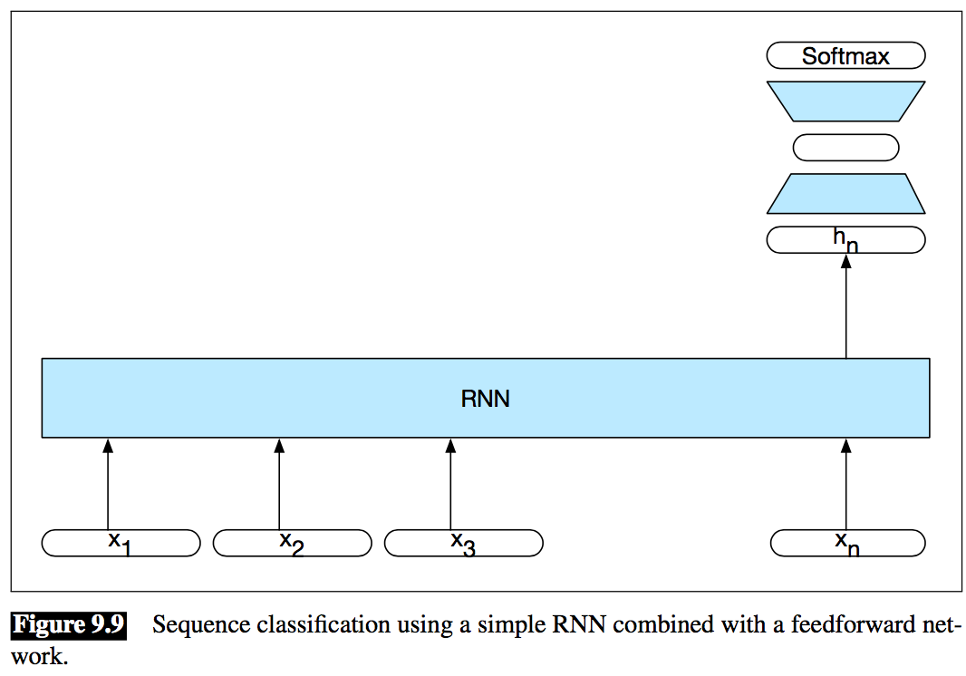
Applications of RNNs (cont’d)
To apply RNNs in this setting, the hidden layer from the final state of the network is taken to constitute a compressed representation of the entire sequence. This compressed sequence representation can then in turn serve as the input to a feed-forward network trained to select the correct class. Fig. 9.9 illustrates this approach.

Slide 18
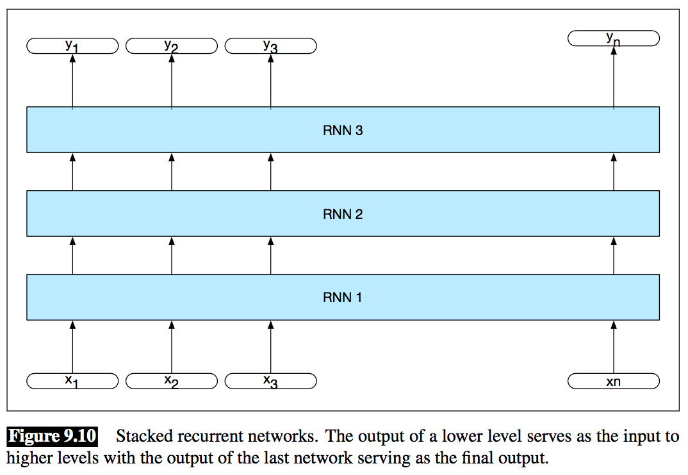
Deep Networks: Stacked and Bidirectional RNNs
Two of the more common network architectures used in language processing with RNNs are as follows.
Stacked RNNs: Stacked RNNs consist of multiple networks where the output of one layer serves as the input to a subsequent layer, as shown in Fig. 9.10. Better than single layer networks.

Slide 19
Deep Networks: Stacked and Bidirectional RNNs
Bidirectional RNNs: Hidden state at time t is the result of a function of the inputs from the start up through time t.
h_{forward} = SRN_{forward} (x₁ : x_{t})
To take advantage of the context to the right of the current input, one way to recover such information is to train a recurrent network on an input sequence in reverse.
h_{backward} = SRN_{backward} (x_{n} : x_{t})
Putting these networks together results in a bidirectional RNN.
h_{t} = h_{t} ^{forward} ⊕ h_{t}^{backward} (9.7)
Fig. 9.11 illustrates a bidirectional network where the outputs of the forward and backward pass are concatenated.

Slide 20
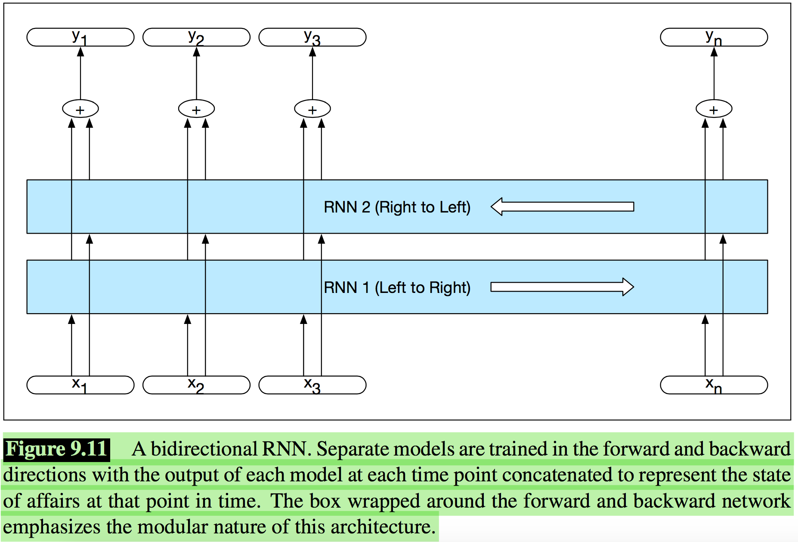
Deep Networks: Stacked and Bidirectional RNNs
Concatenation is a common approach to combining the two outputs but element-wise summation, multiplication or averaging are also used.

Slide 21
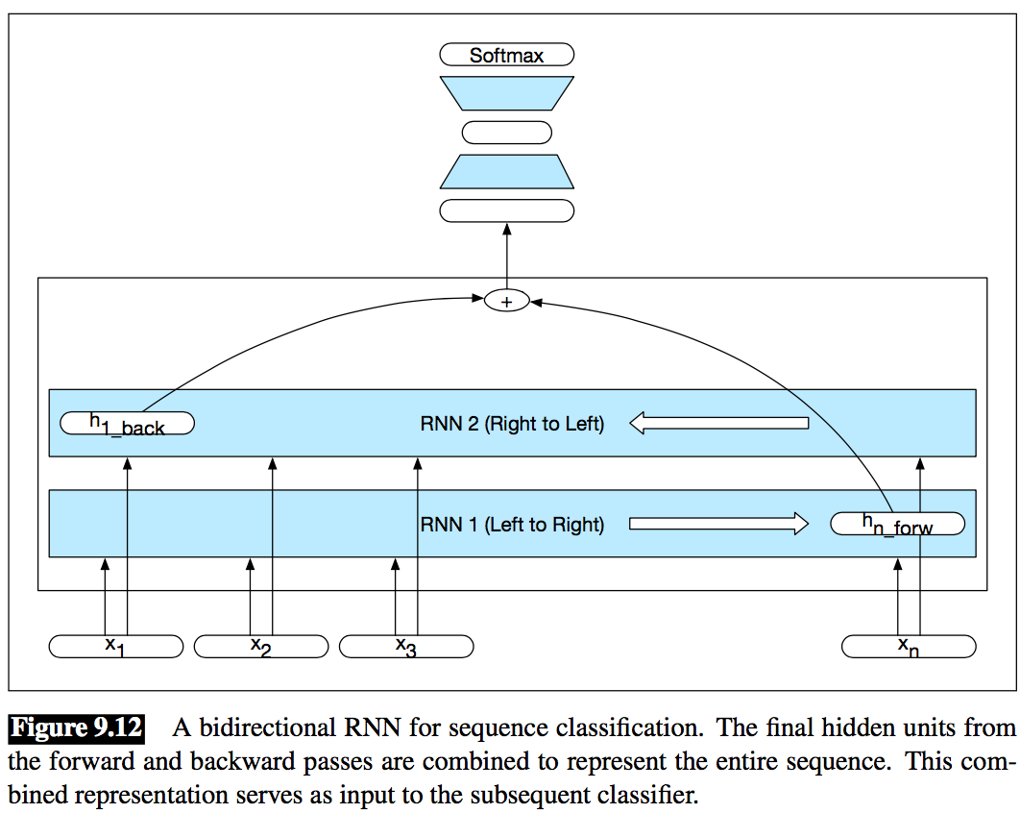
Deep Networks: Stacked and Bidirectional RNNs

Slide 22
Managing Context in RNNs: LSTMs and GRUs
It is quite difficult to train simple RNNs for tasks that require a network to make use of information distant from the current point of processing.
(9.8) The flights the airline was cancelling were full.
Assigning a high probability to was following airline is straightforward since was provides a strong local context for the singular agreement. However, assigning an appropriate probability to were is quite difficult, not only because the plural flights is quite distant, but also because the more recent context contains singular constituents.
SRNs are unable to carry forward critical information.
Hidden layer at time t contributes to the loss at the next time step. So loosing failure in distant information.

Slide 23
Managing Context in RNNs: LSTMs and GRUs
To address these issues more complex network architectures have been designed to explicitly manage the task of maintaining contextual information over time.
Network needs to forget information that is no longer needed and to remember information as needed for later decisions.
Long Short-Term Memory: Long short-term memory (LSTM) networks, divide the context management problem into two sub-problems: removing information no longer needed from the context, and adding information likely to be needed for later decision making.
LSTMs accomplish this through the use of specialized neural units that make use of gates that control the flow of information into and out of the units that comprise the network layers. These gates are implemented through the use of additional sets of weights that operate sequentially on the context layer.

Slide 24
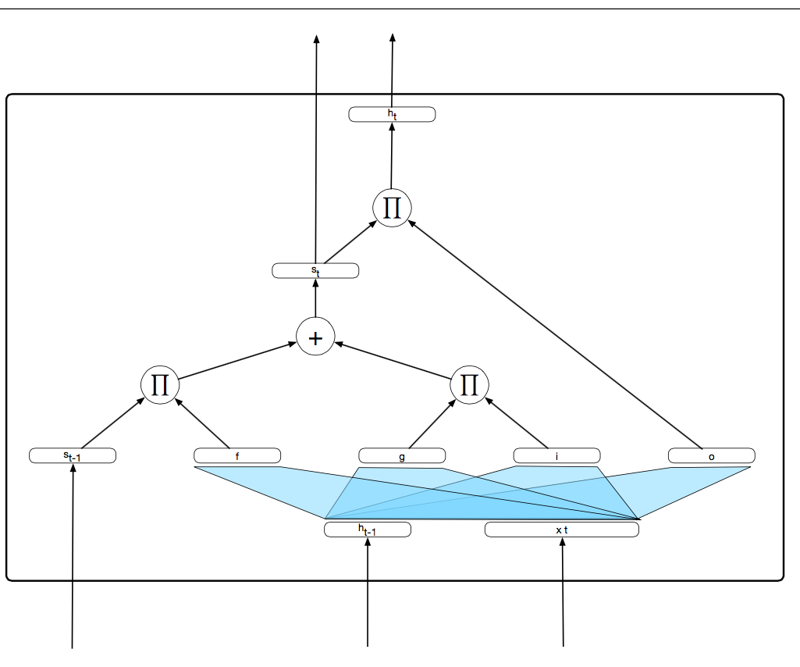
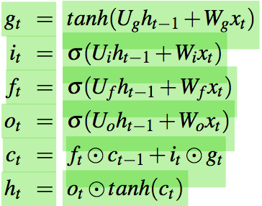
Managing Context in RNNs: LSTMs and GRUs
C_{t}=s_{t}
C_{t-1}=s_{t-1}

Slide 25
Managing Context in RNNs: LSTMs and GRUs
Gated Recurrent Units: While relatively easy to deploy, LSTMs introduce a considerable number of parameters to our networks, and hence carry a much larger training burden. Gated Recurrent Units (GRUs) try to ease this burden by collapsing the forget and add gates of LSTMs into a single update gate with a single set of weights.

Slide 26
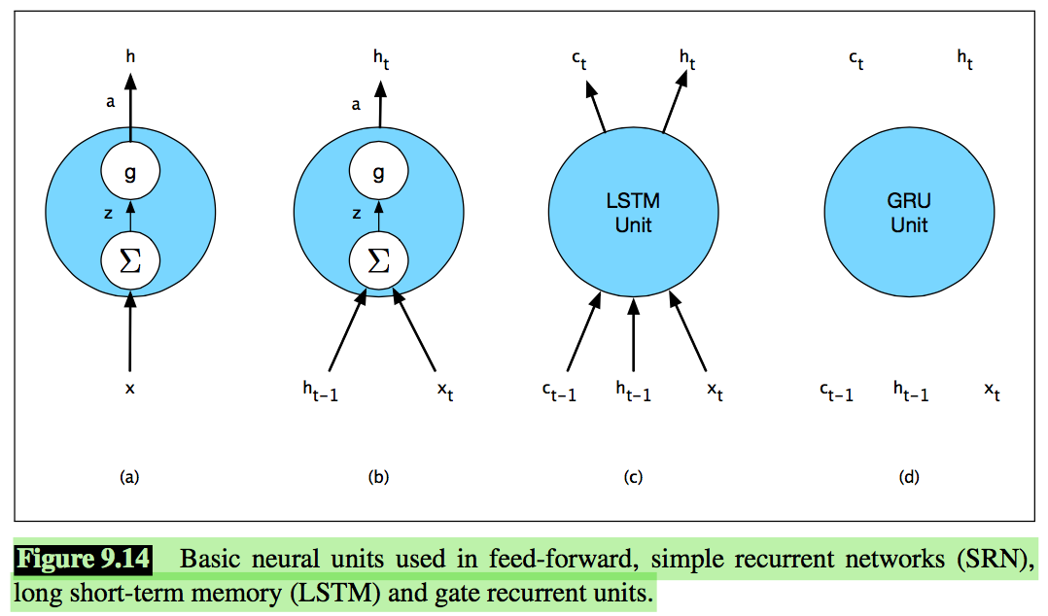
Managing Context in RNNs: LSTMs and GRUs
Gated Units, Layers and Networks: Fig. 9.14 which illustrates the inputs/outputs and weights associated with each kind of unit.

Slide 27
Managing Context in RNNs: LSTMs and GRUs
At left, (a) is the basic feed-forward unit h = g(W x + b). A single set of weights and a single activation function determine its output, and when arranged in a layer there is no connection between the units in the layer.
Next, (b) represents the unit in an SRN. Now there are two inputs and additional set of weights to go with it. However, there is still a single activation function and output. When arranged as a layer the hidden layer from each unit feeds in as an input to the next.
Increased complexity of the LSTM and GRU units is encapsulated within the units themselves.
The only additional external complexity over the basic recurrent unit (b) is the presence of the additional context vector input and output.

Slide 28
Words, Characters and Byte-Pairs
There are significant issues with any solely word-based approach:
For some languages and applications, the lexicon is simply too large to practically represent every possible word as an embedding. Some means/rules of composing words from smaller bits is needed.
No matter how large the lexicon, we will always encounter unknown words due to new words entering the language, misspellings and borrowings from other languages.
Morphological information, below the word level, is clearly an important source of information for many applications. Word-based methods are blind to such regularities.
We can overcome some of these issues by augmenting our input word representations with embeddings derived from the characters that make up the words.

Slide 29
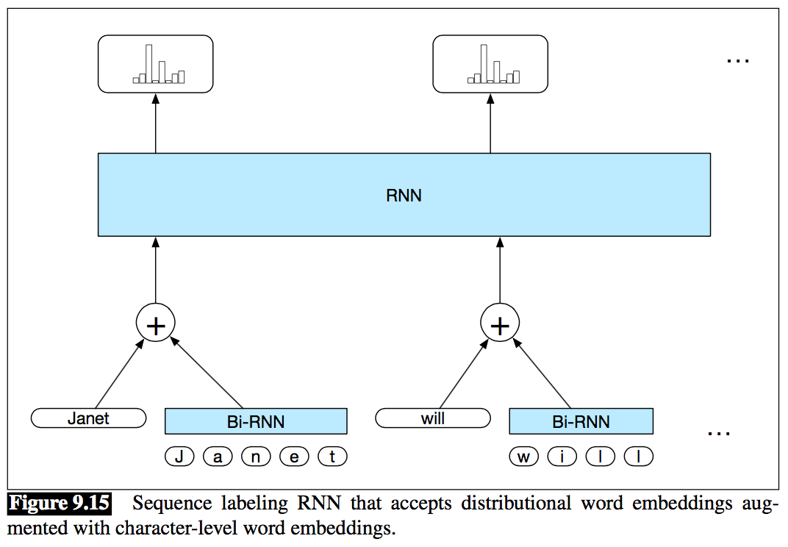
Words, Characters and Byte-Pairs
Each input consists of the concatenation of the normal word embedding with embeddings derived from a bidirectional RNN that accepts the character sequences for each word as input

Slide 30
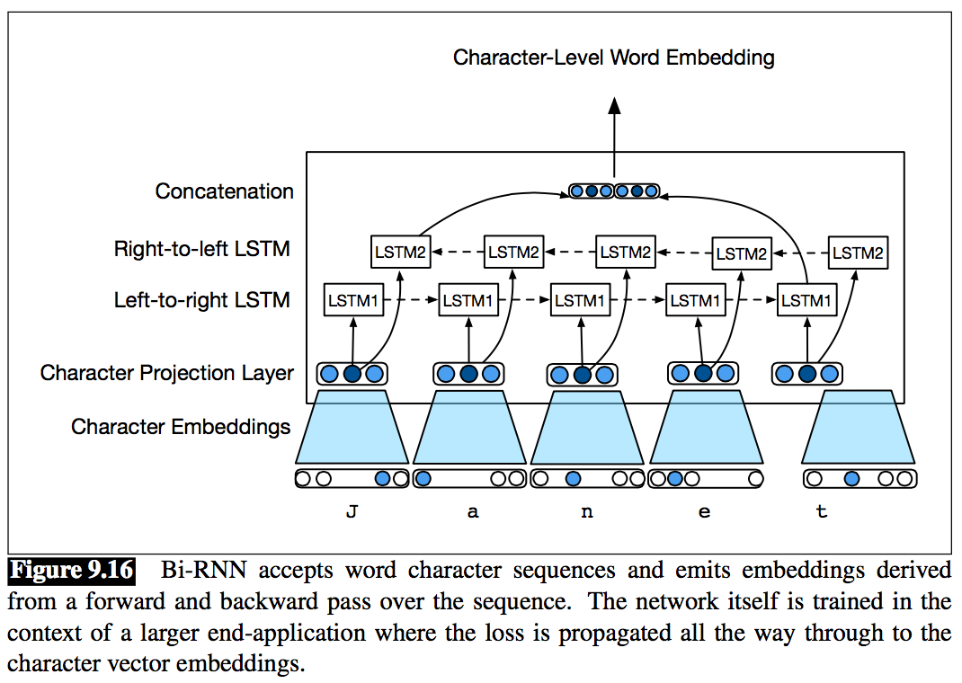
Words, Characters and Byte-Pairs
The character sequence for each word in the input is run through a bidirectional RNN consisting of two independent RNNs — one that processes the sequence left-to-right and the other right-to-left as shown in Fig 9.16.

Slide 31
Home Work # 4
Read the following blog and try to Implementing an RNN from scratch in Python.
https://towardsdatascience.com/recurrent-neural-networks-rnns-3f06d7653a85
OR
https://datascience-enthusiast.com/DL/Building_a_Recurrent_Neural_Network-Step_by_Step_v1.html

Slide 32
Exercises
Q1: Can you think of a few applications for a sequence-to-sequence RNN? What about a sequence-to-vector RNN? And a vector-to-sequence RNN?
Sol:
Here are a few RNN applications:
For a sequence-to-sequence RNN: predicting the weather (or any other time series), machine translation (using an encoder–decoder architecture), video captioning, speech to text, music generation (or other sequence generation), identifying the chords of a song.
For a sequence-to-vector RNN: classifying music samples by music genre, analyzing the sentiment of a book review, predicting what word an aphasic patient is thinking of based on readings from brain implants, predicting the probability that a user will want to watch a movie based on her watch history (this is one of many possible implementations of collaborative filtering).
For a vector-to-sequence RNN: image captioning, creating a music playlist based on an embedding of the current artist, generating a melody based on a set of parameters, locating pedestrians in a picture (e.g., a video frame from a self-driving car’s camera).

Slide 33
Exercises
Q2: Why do people use encoder–decoder RNNs rather than plain sequence-to-sequence RNNs for automatic translation?
Sol:
In general, if you translate a sentence one word at a time, the result will be terrible. For example, the French sentence “Je vous en prie” means “You are welcome,” but if you translate it one word at a time, you get “I you in pray.” Huh? It is much better to read the whole sentence first and then translate it. A plain sequence-to-sequence RNN would start translating a sentence immediately after reading the first word, while an encoder–decoder RNN will first read the whole sentence and then translate it. That said, one could imagine a plain sequence-to-sequence RNN that would output silence whenever it is unsure about what to say next (just like human translators do when they must translate a live broadcast).

Slide 34
Exercises
Q3: How could you combine a convolutional neural network with an RNN to classify videos?
Sol:
To classify videos based on the visual content, one possible architecture could be to take (say) one frame per second, then run each frame through a convolutional neural network, feed the output of the CNN to a sequence-to-vector RNN, and finally run its output through a softmax layer, giving you all the class probabilities. For training you would just use cross entropy as the cost function. If you wanted to use the audio for classification as well, you could convert every second of audio to a spectrograph, feed this spectrograph to a CNN, and feed the output of this CNN to the RNN (along with the corresponding output of the other CNN).

Slide 35
Exercises
Q4: What are the advantages of building an RNN using dynamic_rnn() rather than static_rnn()?
Sol:
Building an RNN using dynamic_rnn() rather than static_rnn() offers several advantages:
It is based on a while_loop() operation that is able to swap the GPU’s memory to the CPU’s memory during backpropagation, avoiding out-of-memory errors.
It is arguably easier to use, as it can directly take a single tensor as input and output (covering all time steps), rather than a list of tensors (one per time step). No need to stack, unstack, or transpose.
It generates a smaller graph, easier to visualize in TensorBoard.

Slide 36
Exercises
Q5: How can you deal with variable-length input sequences? What about variable-length output sequences?
Sol:
To handle variable length input sequences, the simplest option is to set the sequence_length parameter when calling the static_rnn() or dynamic_rnn() functions. Another option is to pad the smaller inputs (e.g., with zeros) to make them the same size as the largest input (this may be faster than the first option if the input sequences all have very similar lengths). To handle variable-length output sequences, if you know in advance the length of each output sequence, you can use the sequence_length parameter (for example, consider a sequence-to-sequence RNN that labels every frame in a video with a violence score: the output sequence will be exactly the same length as the input sequence). If you don’t know in advance the length of the output sequence, you can use the padding trick: always output the same size sequence, but ignore any outputs that come after the end-of-sequence token (by ignoring them when computing the cost function).

Slide 37
Exercises
Q6: What is a common way to distribute training and execution of a deep RNN across multiple GPUs?
Sol:
To distribute training and execution of a deep RNN across multiple GPUs, a common technique is simply to place each layer on a different GPU.

